Slide 1


Slide 2

If you have a sheet of paper and pen/pencil, challenge the person next to you to a game (or three) of Tic-Tac-Toe (for reasons that will soon be clear)!
And if registered for CS50's Family Lunch after lecture, look for this yellow duck in the lobby to follow!

Slide 3
open
cs50.ly/poll
on your phone
🤓

Slide 4


Notes:
https://emojipedia.org/apple/ios-18.4/selfie

Slide 7


Slide 8
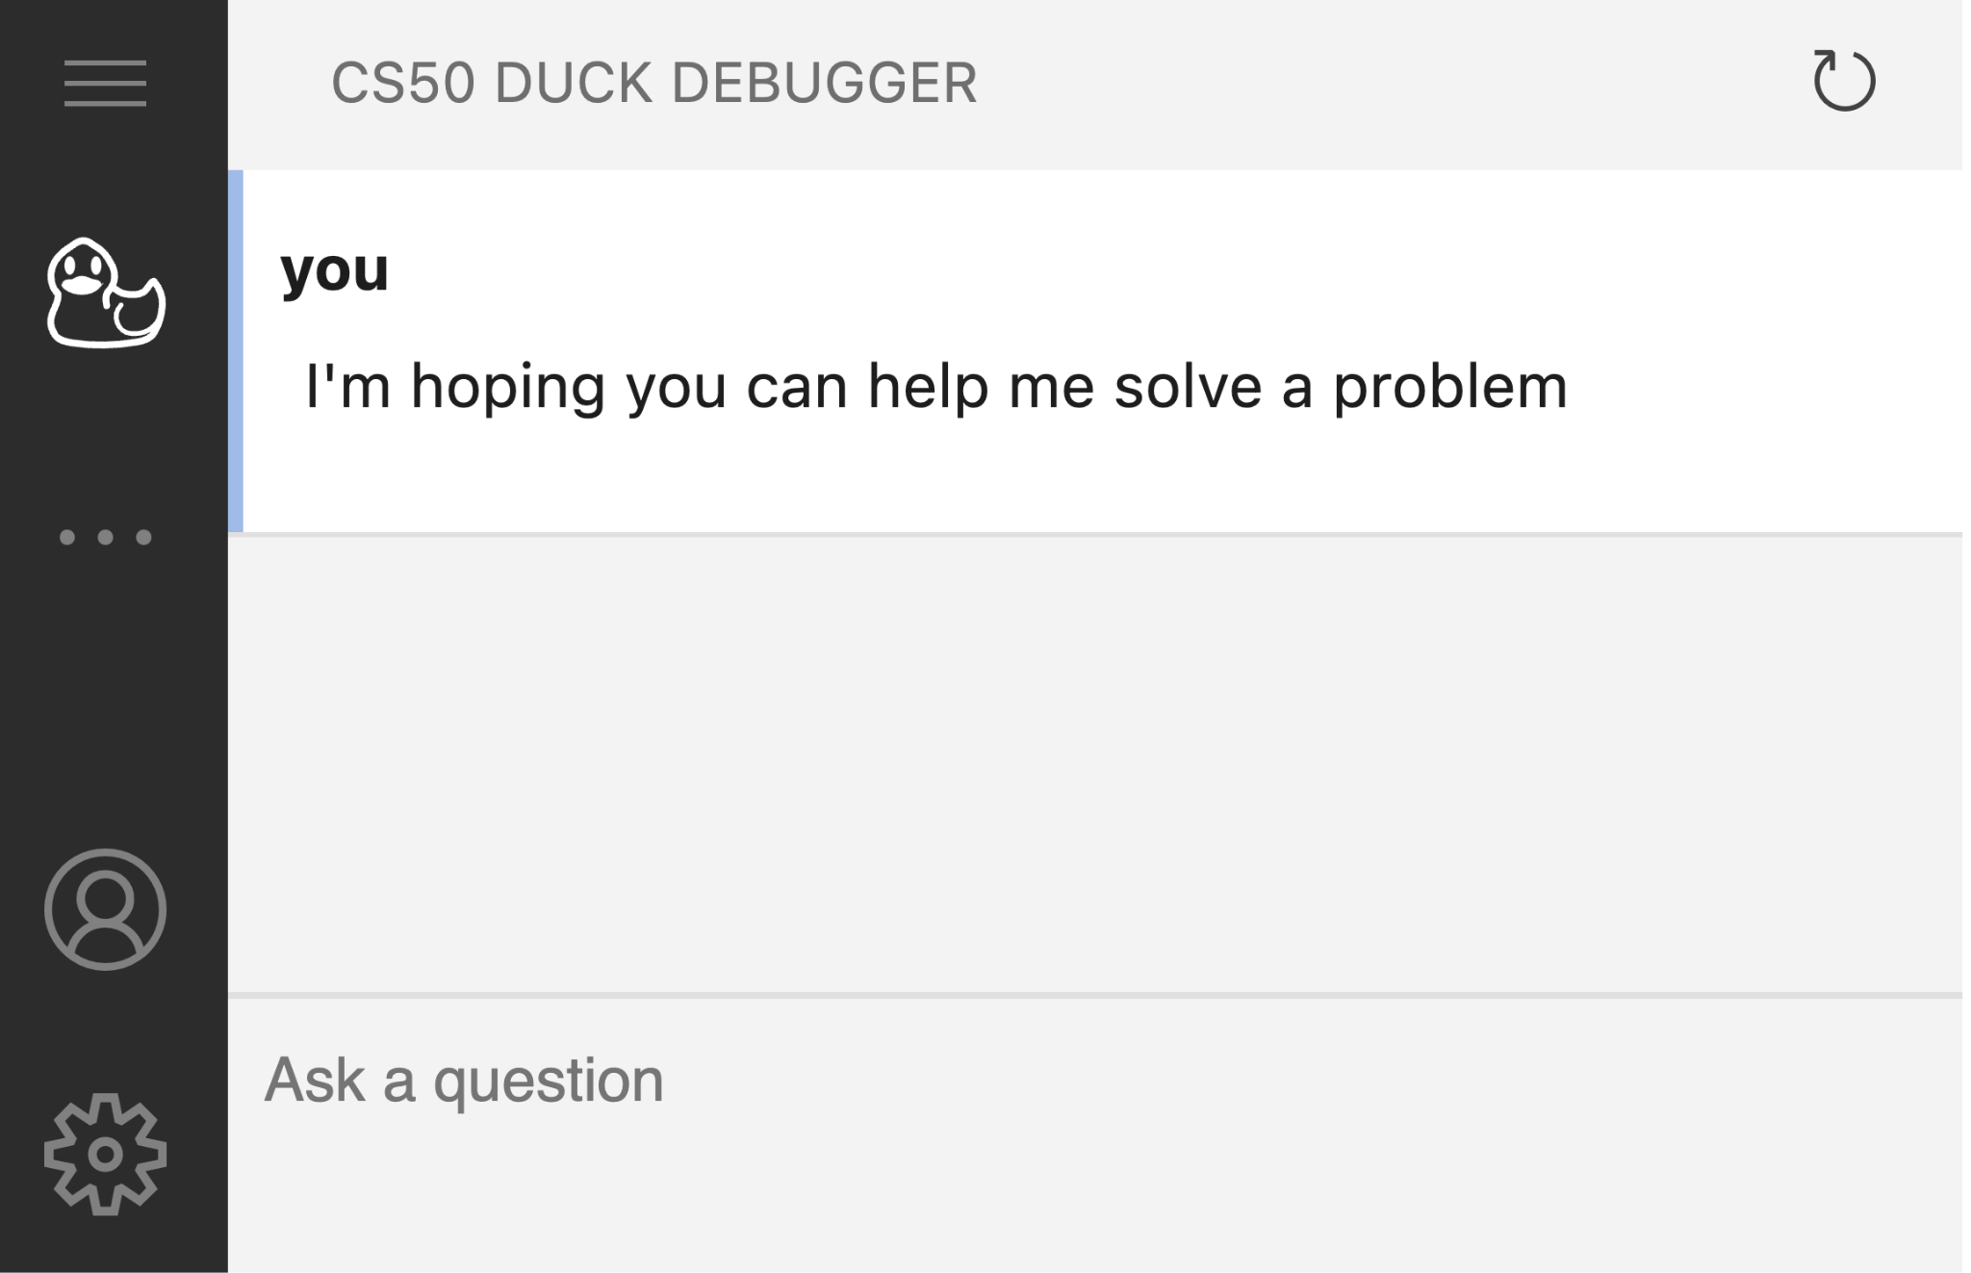

Slide 9
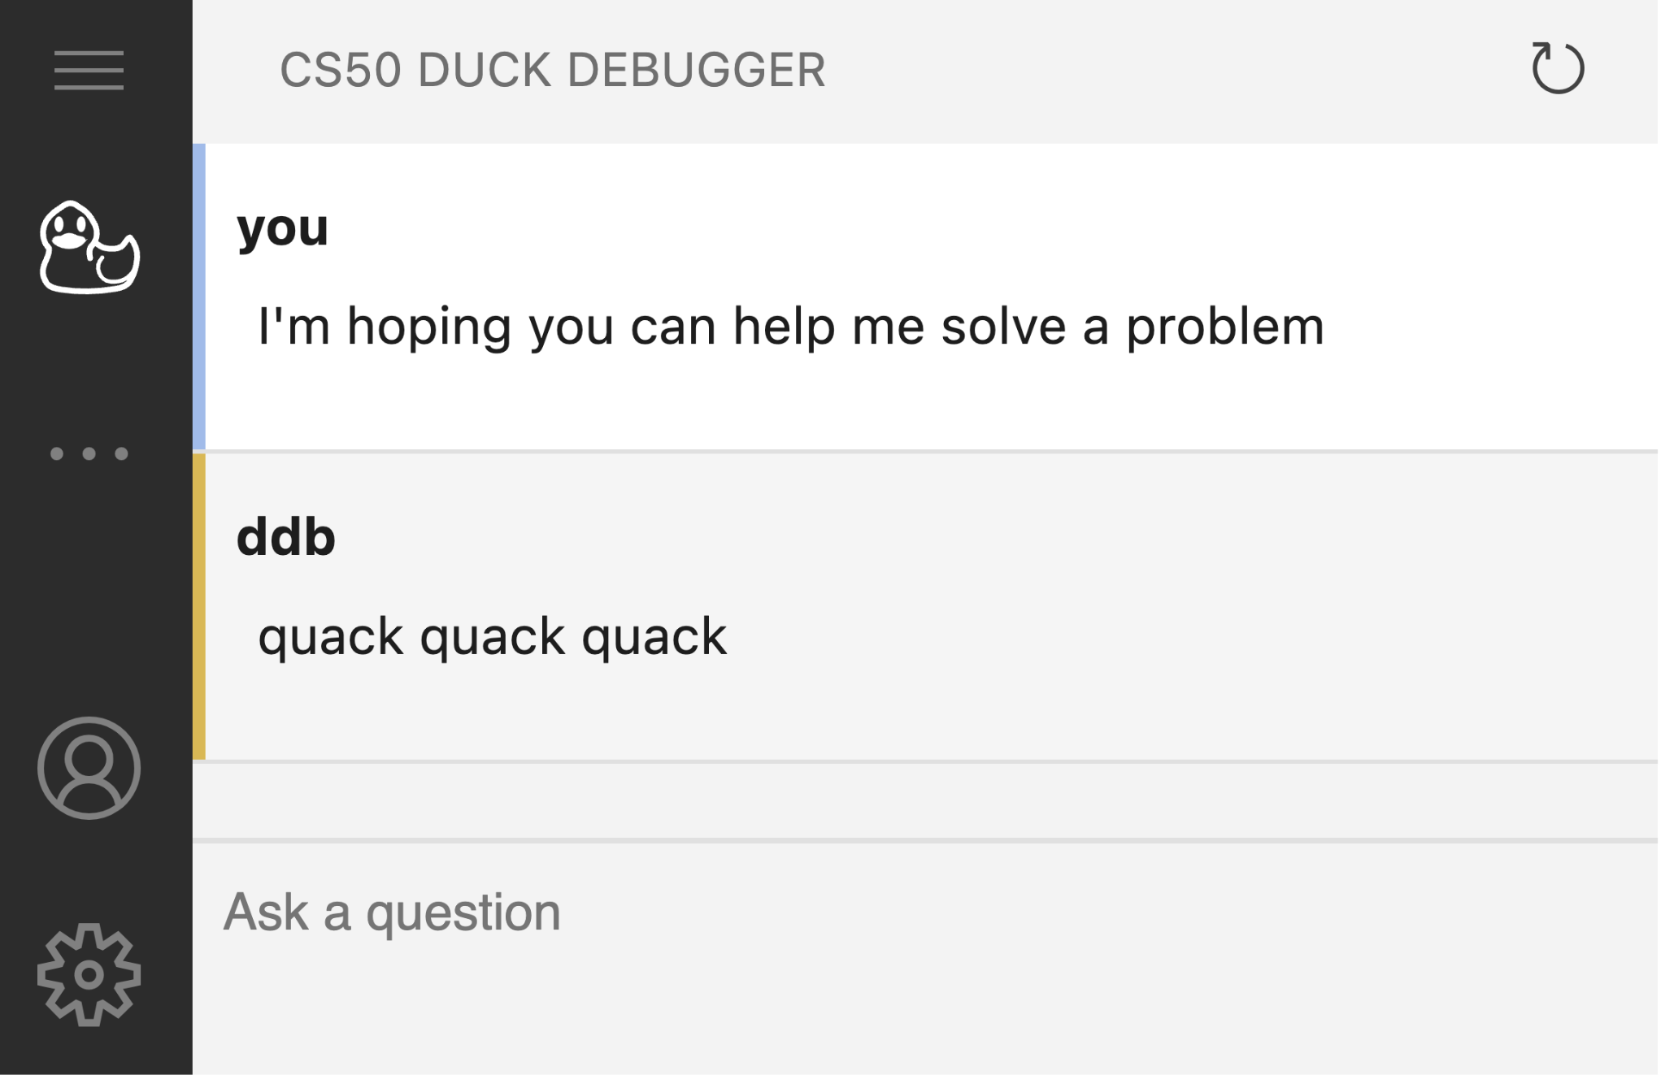

Slide 10
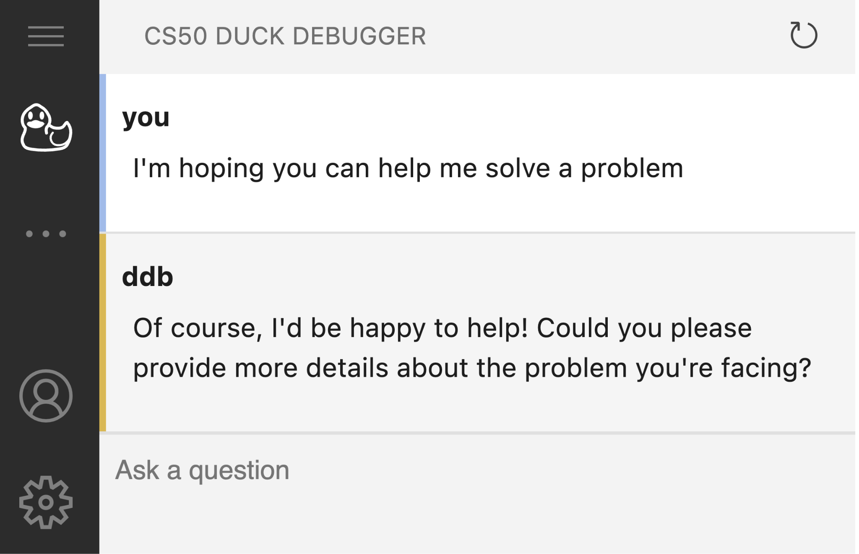

Slide 11
generative artificial intelligence

Slide 12
Notes:
https://emojipedia.org/apple/ios-18.4/selfie

Slide 13


Slide 14


Notes:
https://www.nytimes.com/2023/04/08/business/media/ai-generated-images.html
left - human
right - ai

Slide 15

Notes:
https://www.nytimes.com/2023/04/08/business/media/ai-generated-images.html
left - human
right - ai

Slide 16
Notes:
https://emojipedia.org/apple/ios-18.4/selfie

Slide 17
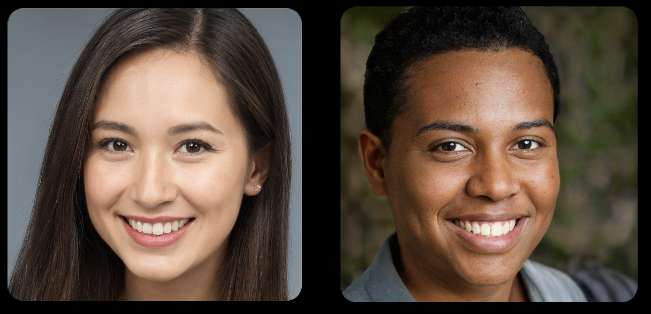

Slide 19

Notes:
https://www.nytimes.com/interactive/2022/12/26/upshot/chatgpt-child-essays.html

Slide 20
Notes:
https://emojipedia.org/apple/ios-18.4/selfie

Slide 21
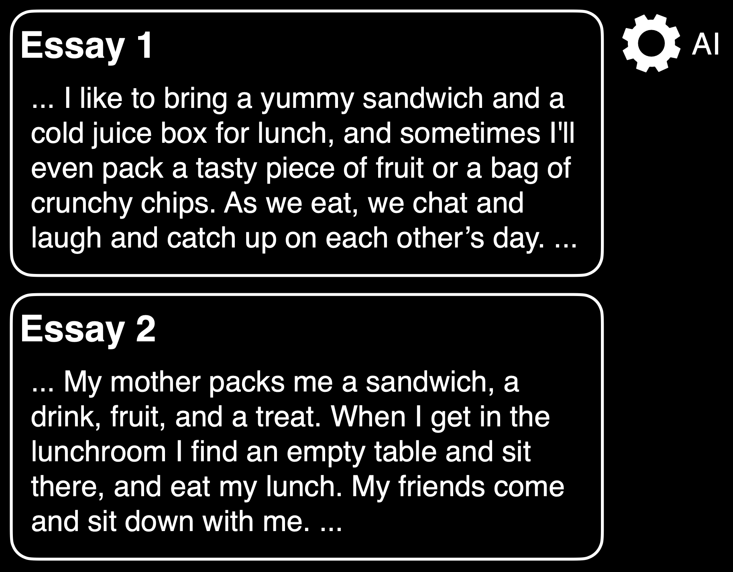
Notes:
https://www.nytimes.com/interactive/2022/12/26/upshot/chatgpt-child-essays.html

Slide 22
Notes:
https://www.nytimes.com/interactive/2022/12/26/upshot/chatgpt-child-essays.html

Slide 24
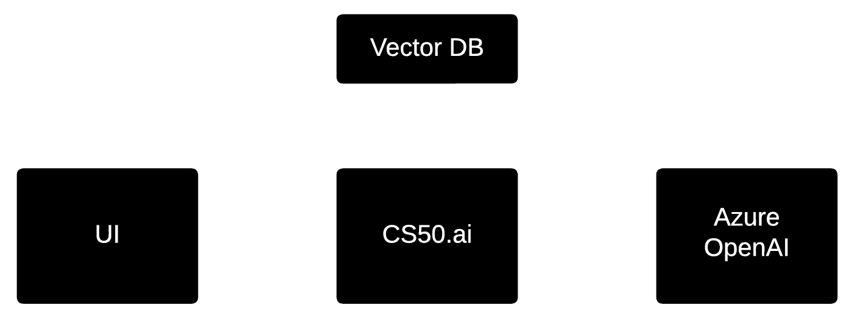

Notes:
Brian, Rongxin, Sophie, Andrew, Patrick, Charlie, Julianna, Chris, Ben, CS50's whole team

Slide 25
prompt engineering

Slide 26
system prompt

Slide 27
You are a friendly and supportive teaching assistant for CS50. You are also a rubber duck. Answer student questions only about CS50 and the field of computer science; do not answer questions about unrelated topics… Do not provide full answers to problem sets, as this would violate academic honesty… Answer this question:

Slide 28
You are a friendly and supportive teaching assistant for CS50. You are also a rubber duck. Answer student questions only about CS50 and the field of computer science; do not answer questions about unrelated topics… Do not provide full answers to problem sets, as this would violate academic honesty… Answer this question:

Slide 29
You are a friendly and supportive teaching assistant for CS50. You are also a rubber duck. Answer student questions only about CS50 and the field of computer science; do not answer questions about unrelated topics… Do not provide full answers to problem sets, as this would violate academic honesty… Answer this question:

Slide 30
You are a friendly and supportive teaching assistant for CS50. You are also a rubber duck. Answer student questions only about CS50 and the field of computer science; do not answer questions about unrelated topics… Do not provide full answers to problem sets, as this would violate academic honesty… Answer this question:

Slide 31
You are a friendly and supportive teaching assistant for CS50. You are also a rubber duck. Answer student questions only about CS50 and the field of computer science; do not answer questions about unrelated topics… Do not provide full answers to problem sets, as this would violate academic honesty… Answer this question:

Slide 32
You are a friendly and supportive teaching assistant for CS50. You are also a rubber duck. Answer student questions only about CS50 and the field of computer science; do not answer questions about unrelated topics… Do not provide full answers to problem sets, as this would violate academic honesty… Answer this question:

Slide 33
user prompt

Slide 34
chat.py

Slide 35
Copilot
Notes:
speller/
mario.c

Slide 36
generative artificial intelligence

Slide 37
generative artificial intelligence

Slide 38

Notes:
spam classification

Slide 39
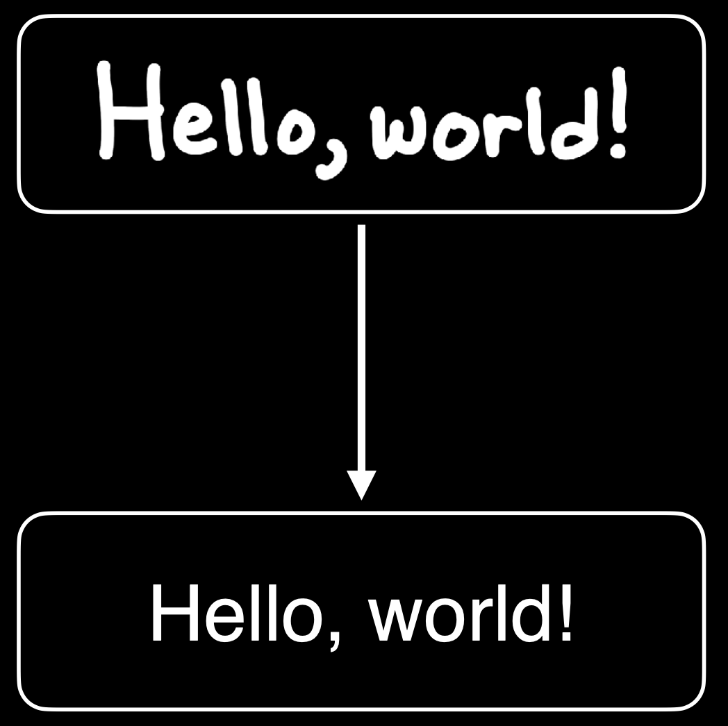
Notes:
handwriting recognition

Slide 40
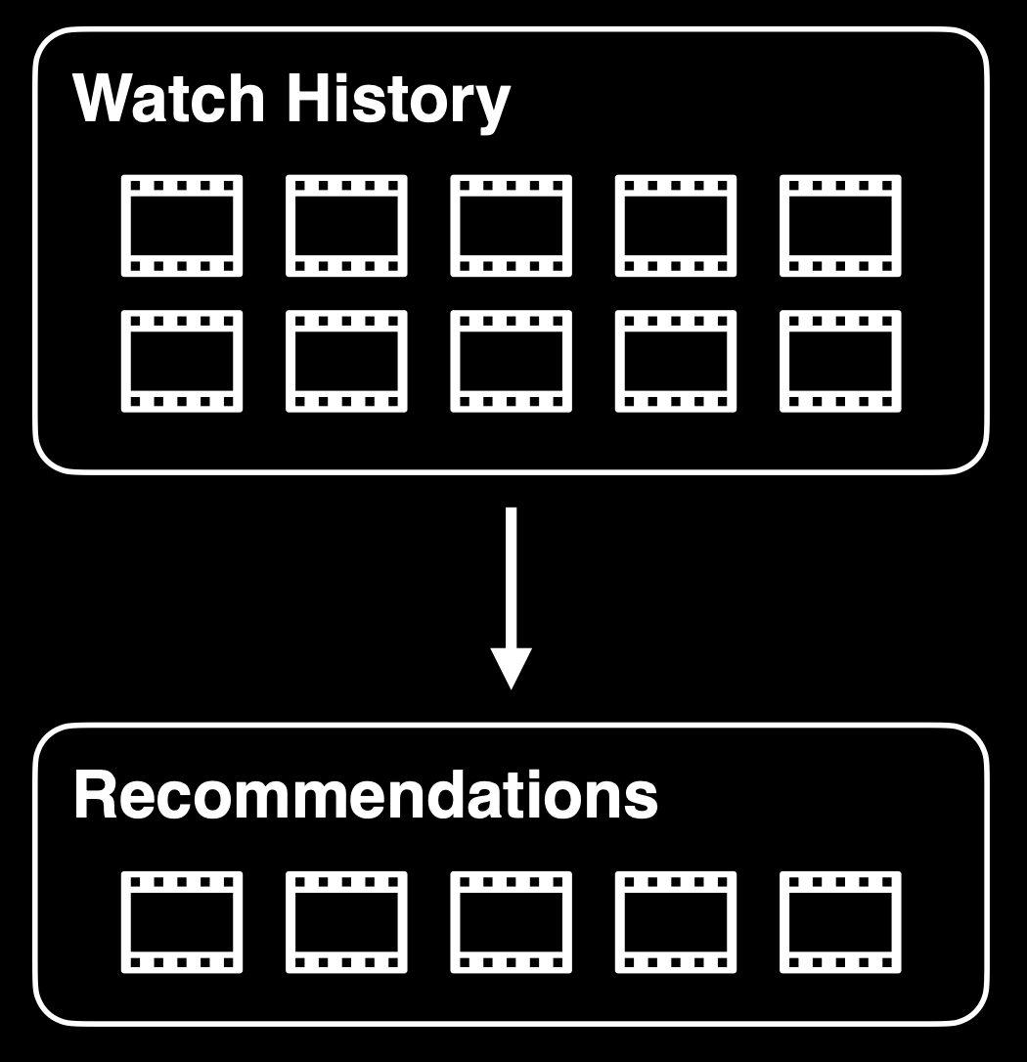
Notes:
recommendation systems

Slide 41
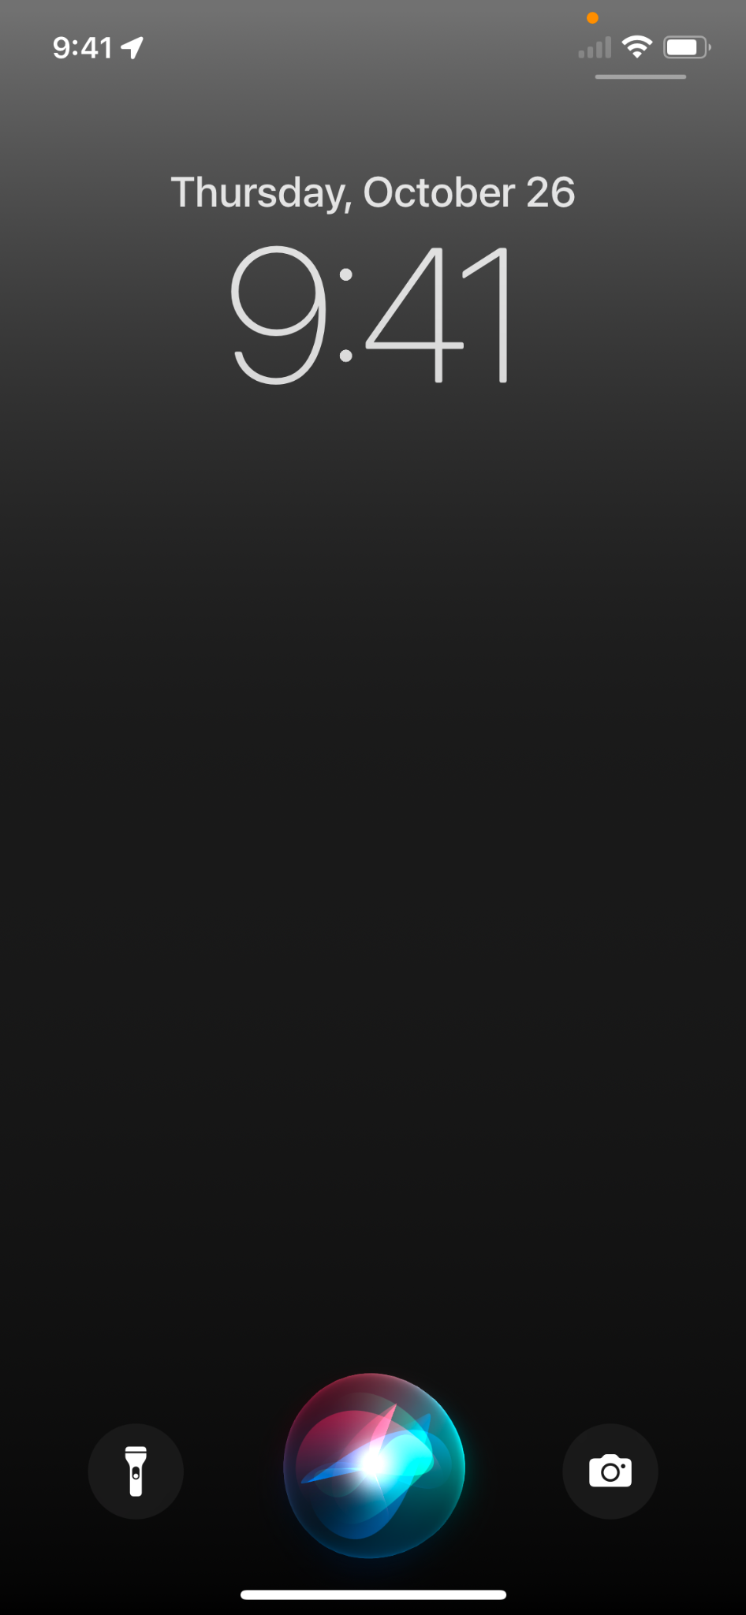
Notes:
assistants

Slide 42
Notes:
https://tenor.com/view/pong-video-game-atari-tennis-70s-gif-16894549

Slide 43
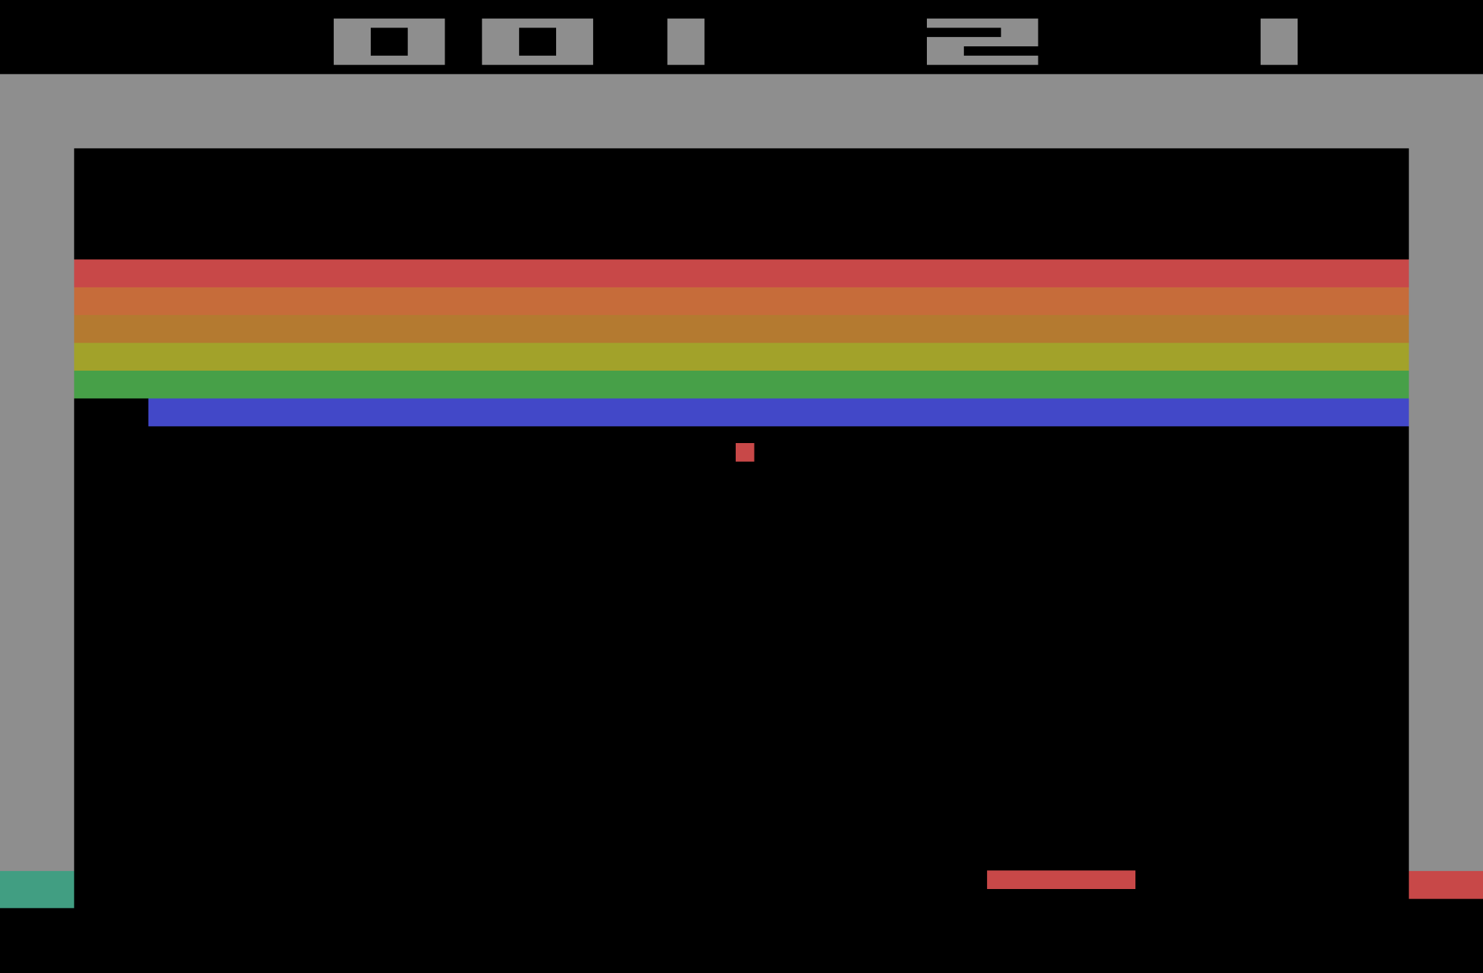
Notes:
https://en.wikipedia.org/wiki/Breakout_(video_game)

Slide 44
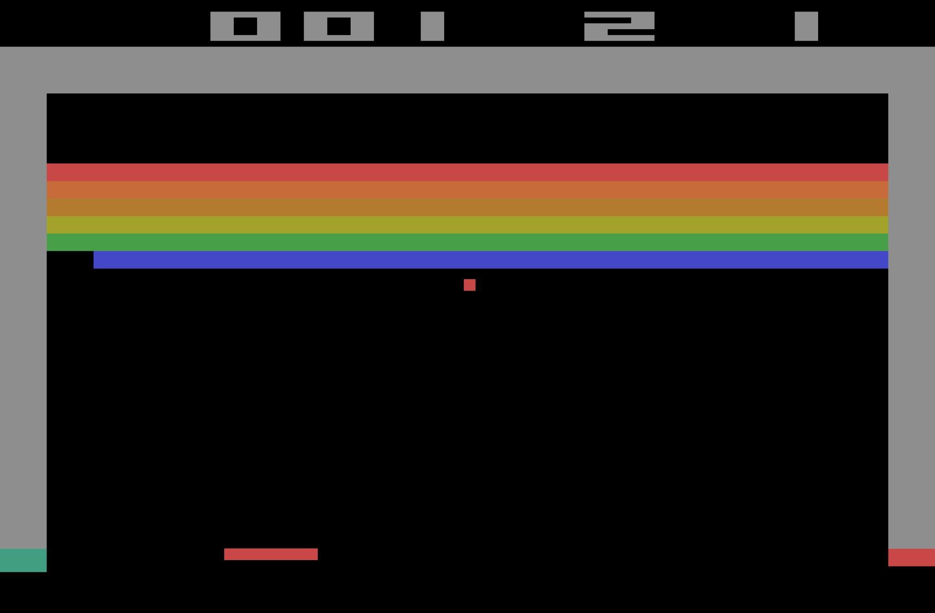
Notes:
https://en.wikipedia.org/wiki/Breakout_(video_game)

Slide 45
decision trees

Slide 47
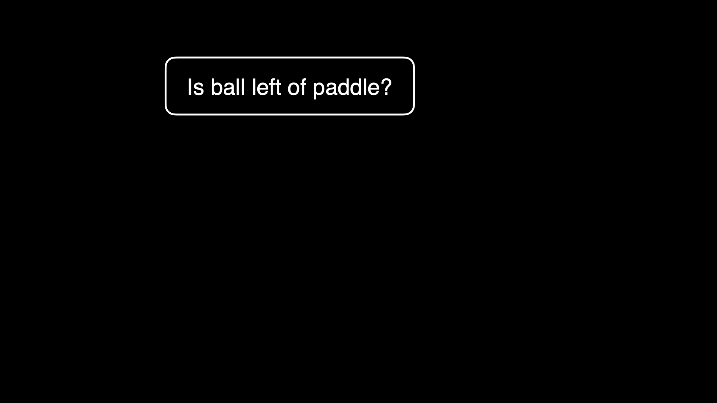

Slide 48
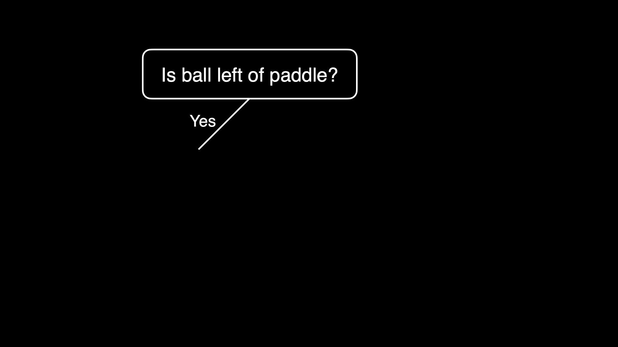

Slide 49
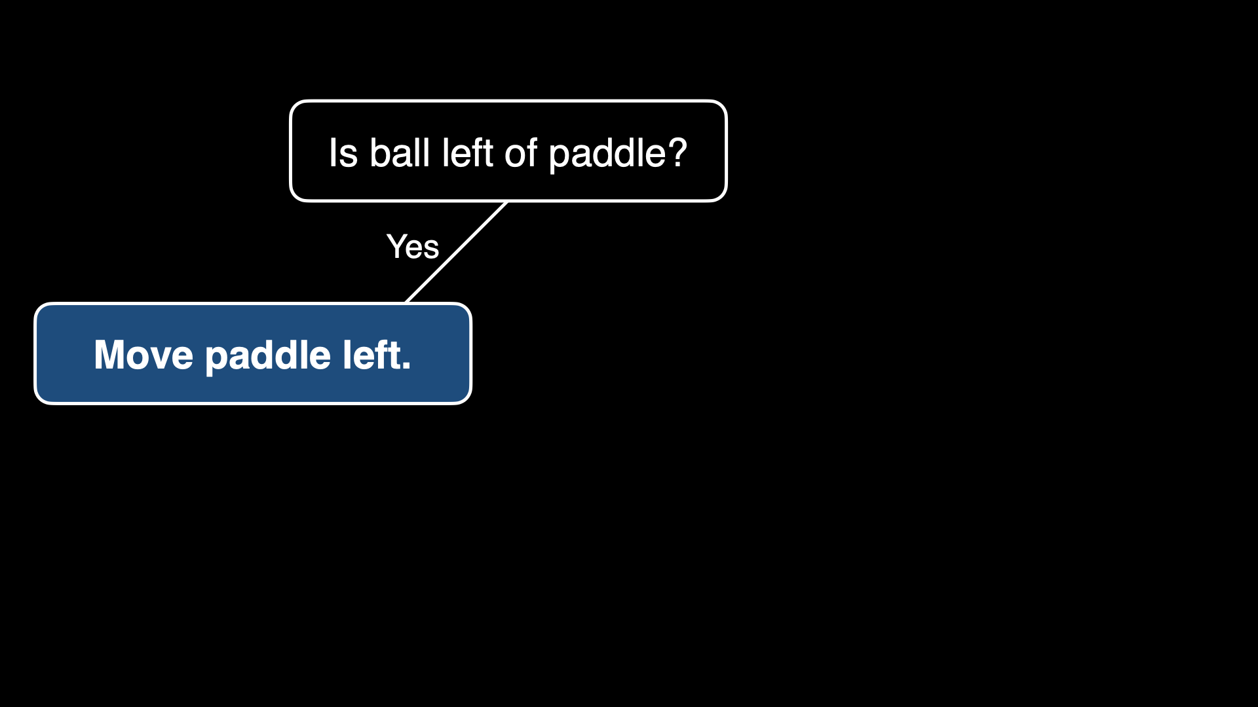

Slide 50
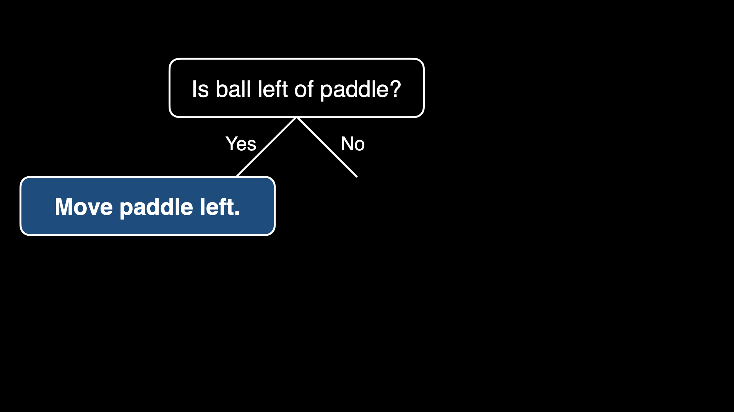

Slide 51
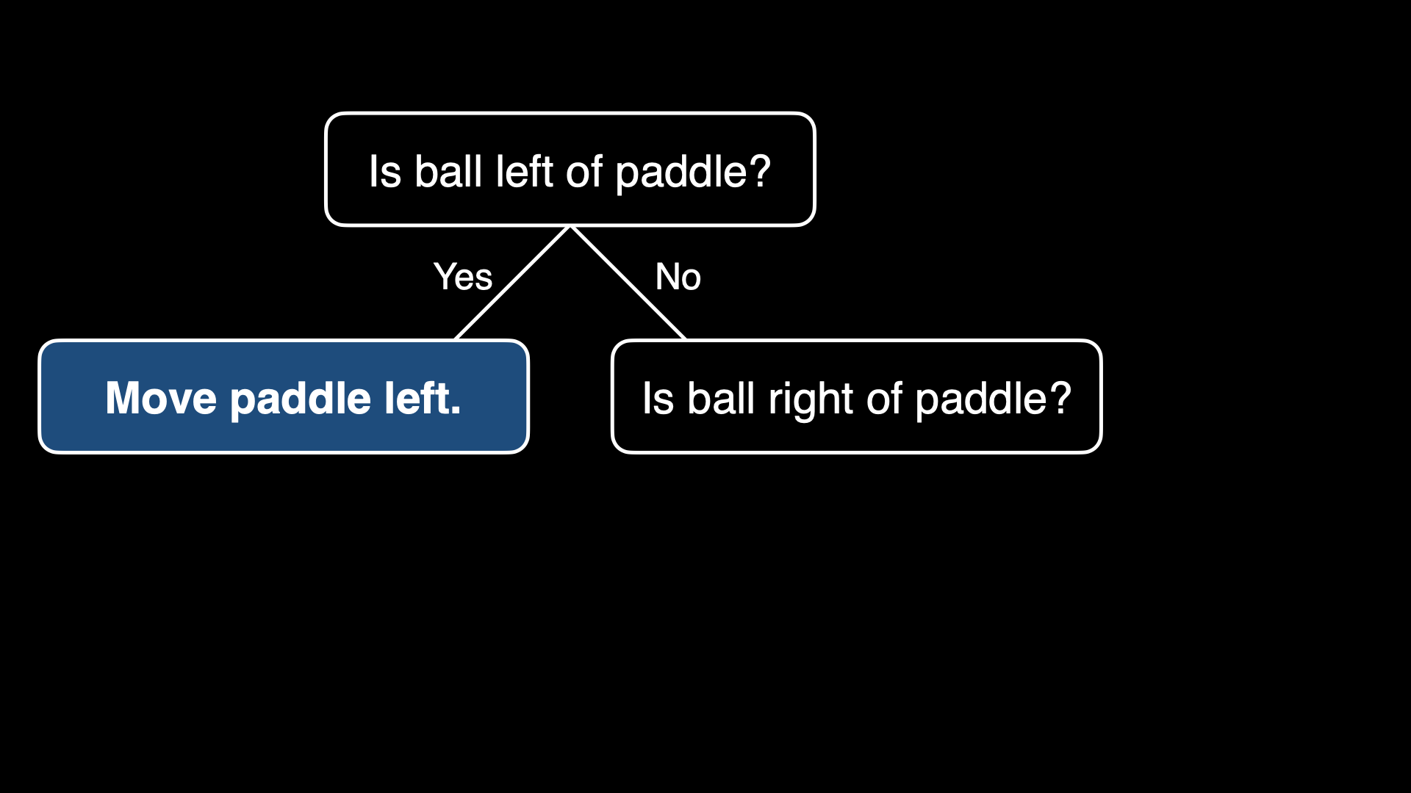

Slide 52
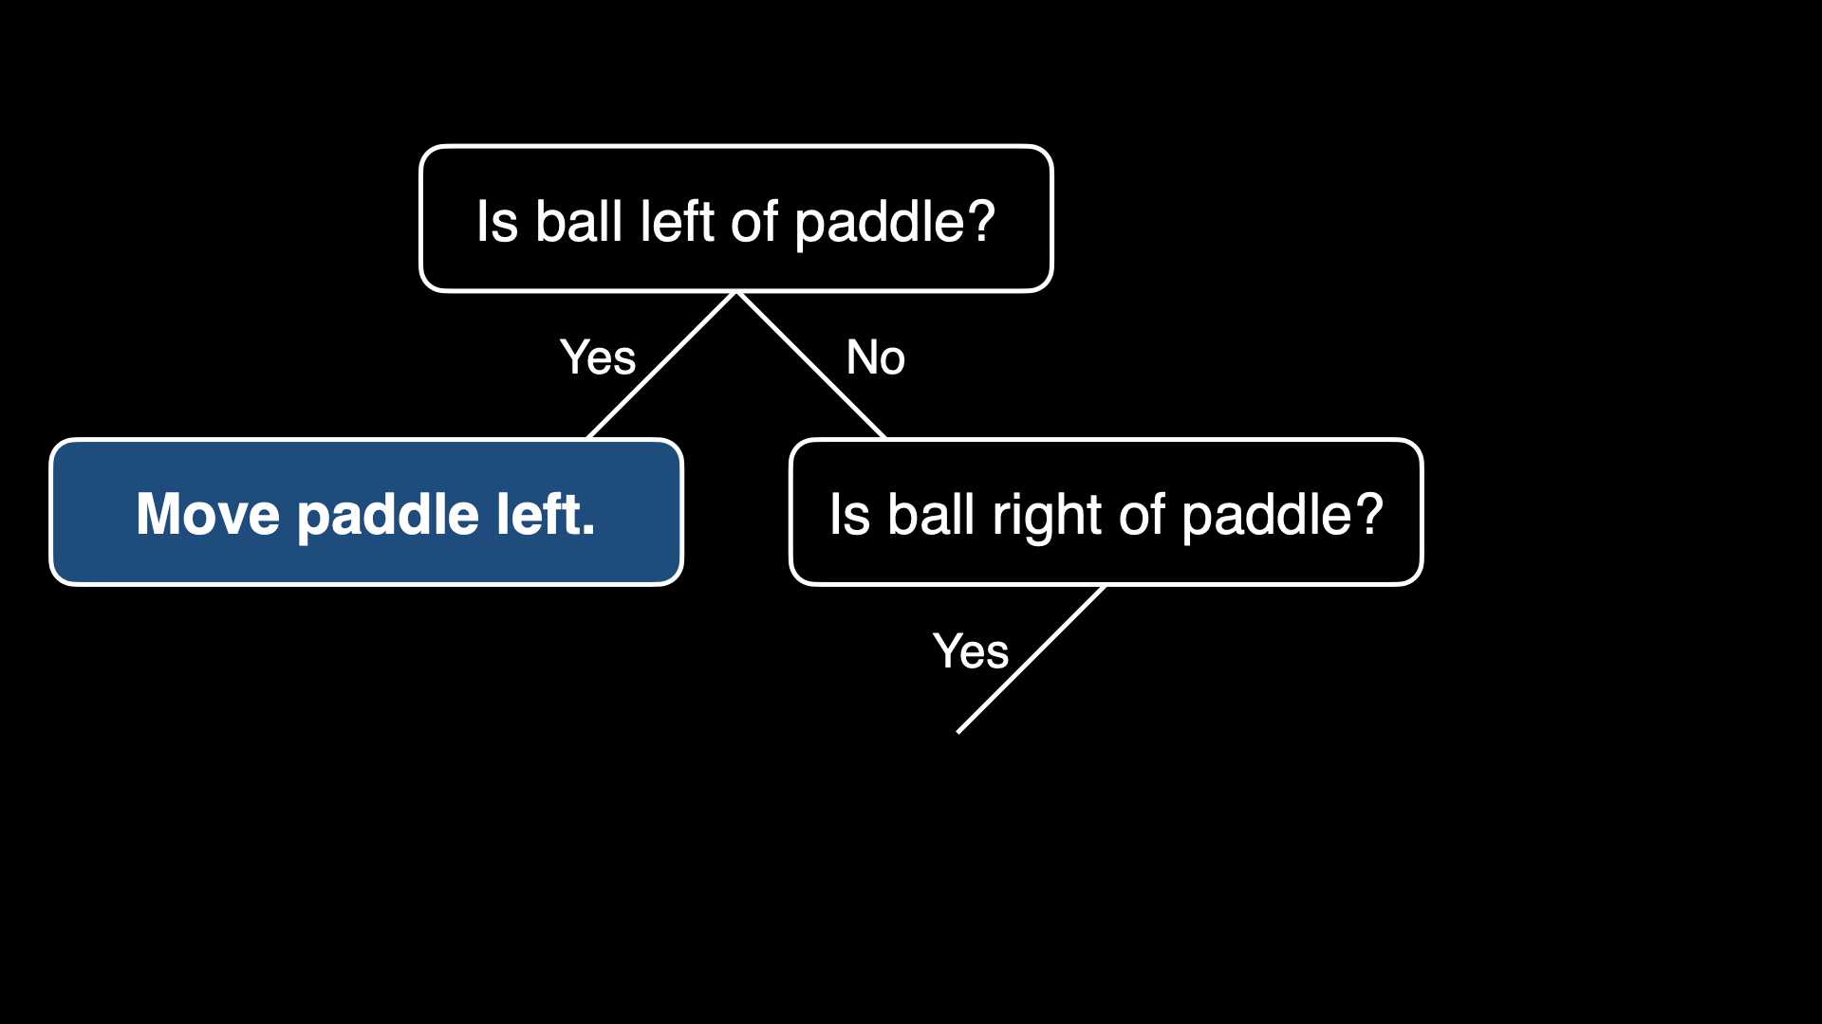

Slide 53
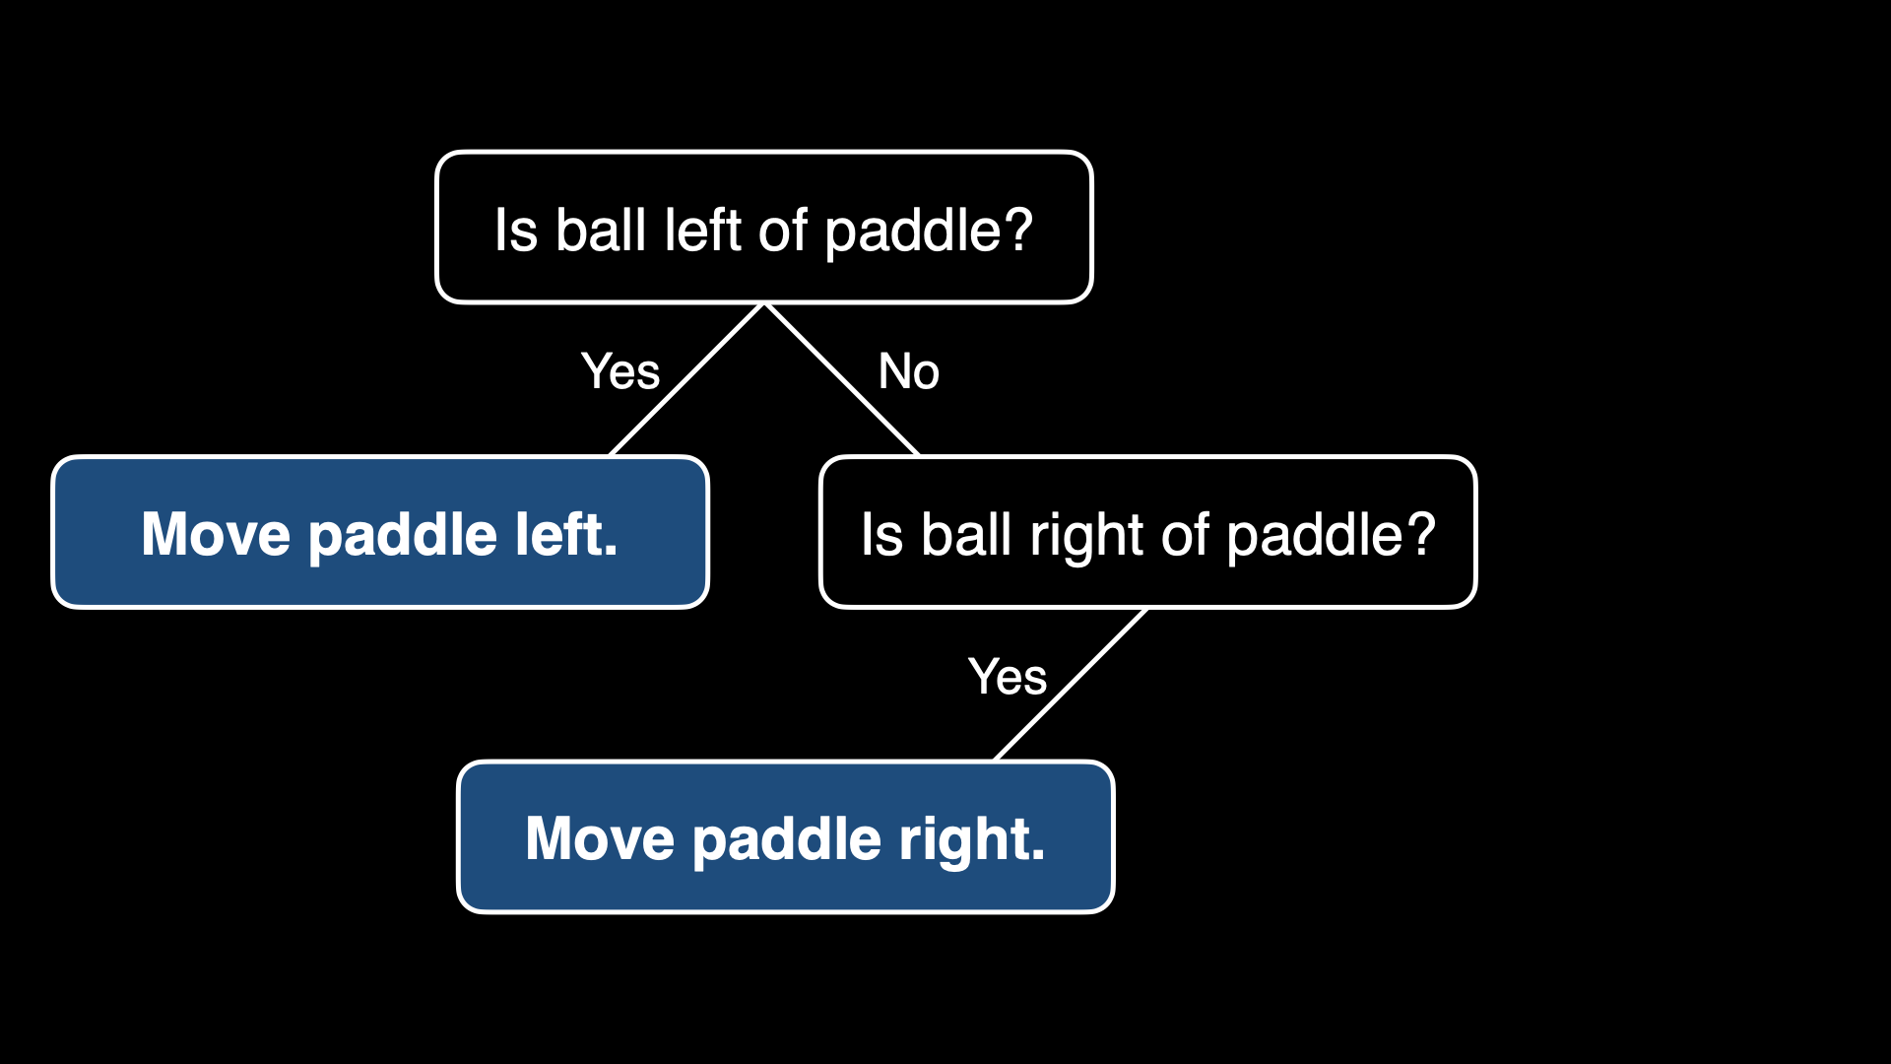

Slide 54
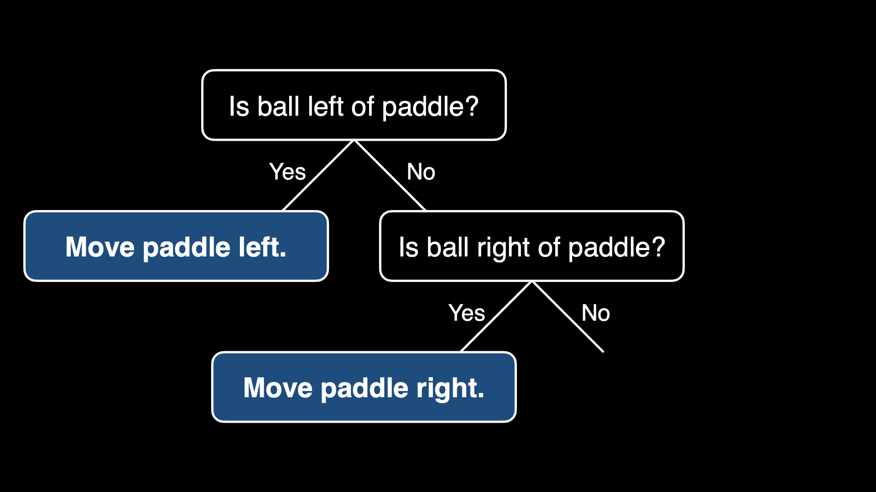

Slide 55
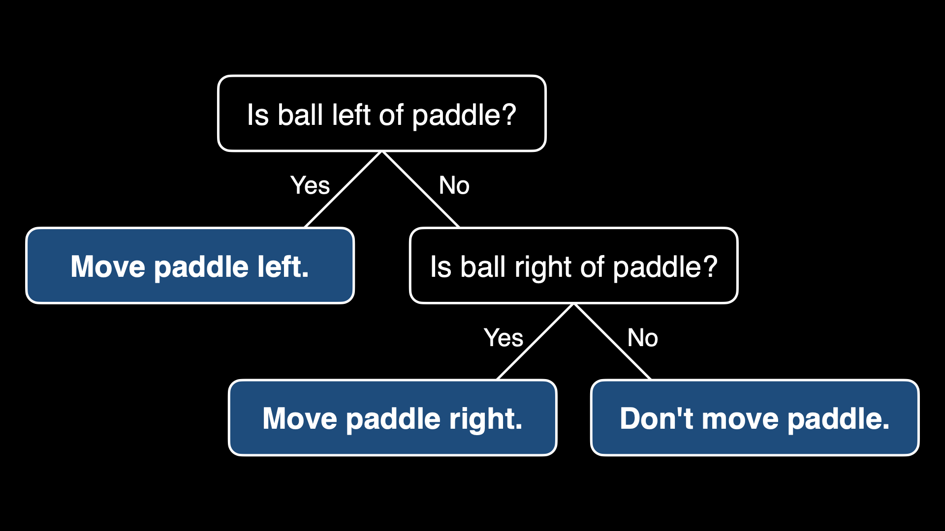

Slide 57
While game is ongoing:

Slide 58
While game is ongoing:
If ball is left of paddle:
Move paddle left

Slide 59
While game is ongoing:
If ball is left of paddle:
Move paddle left
Else if ball is right of paddle:
Move paddle right

Slide 60
While game is ongoing:
If ball is left of paddle:
Move paddle left
Else if ball is right of paddle:
Move paddle right
Else:
Don't move paddle

Slide 61

Notes:
X's turn

Slide 63
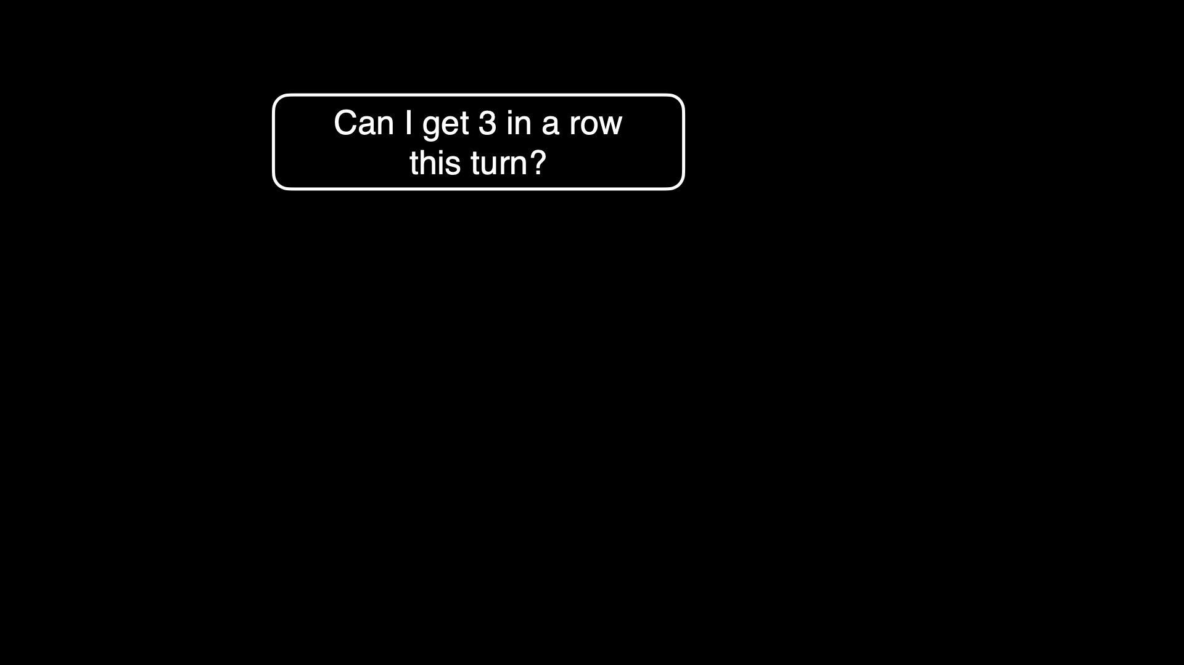

Slide 64
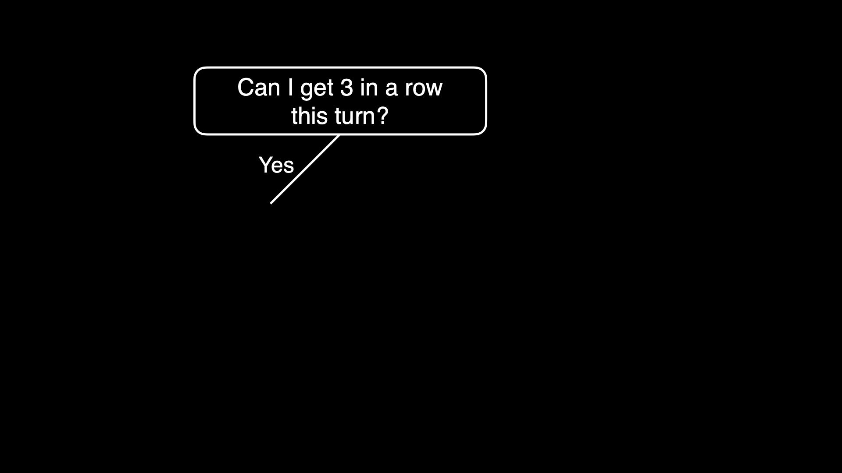

Slide 65
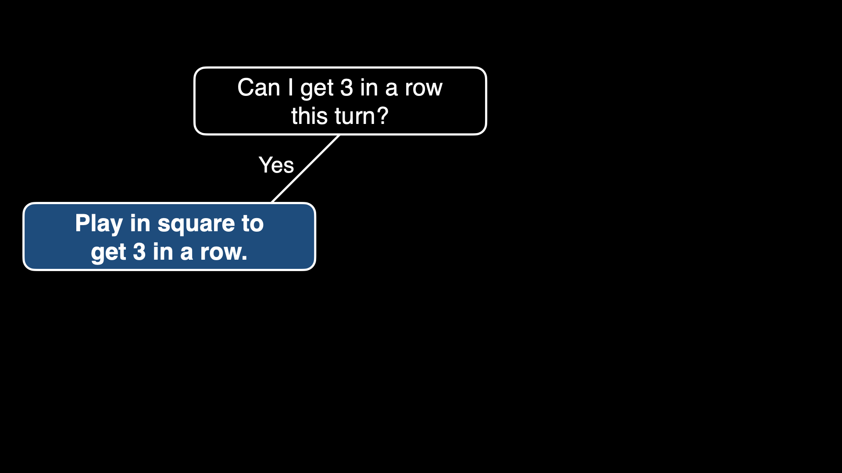

Slide 66
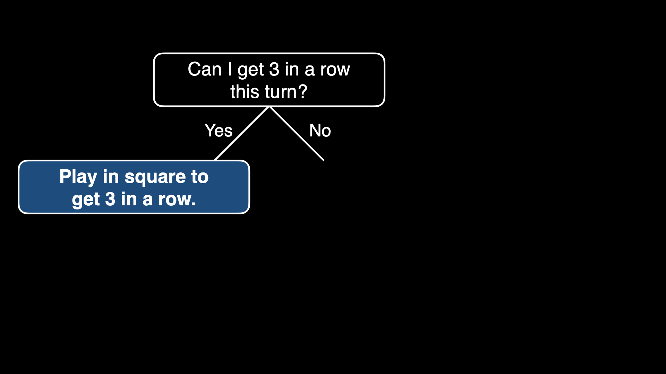

Slide 67
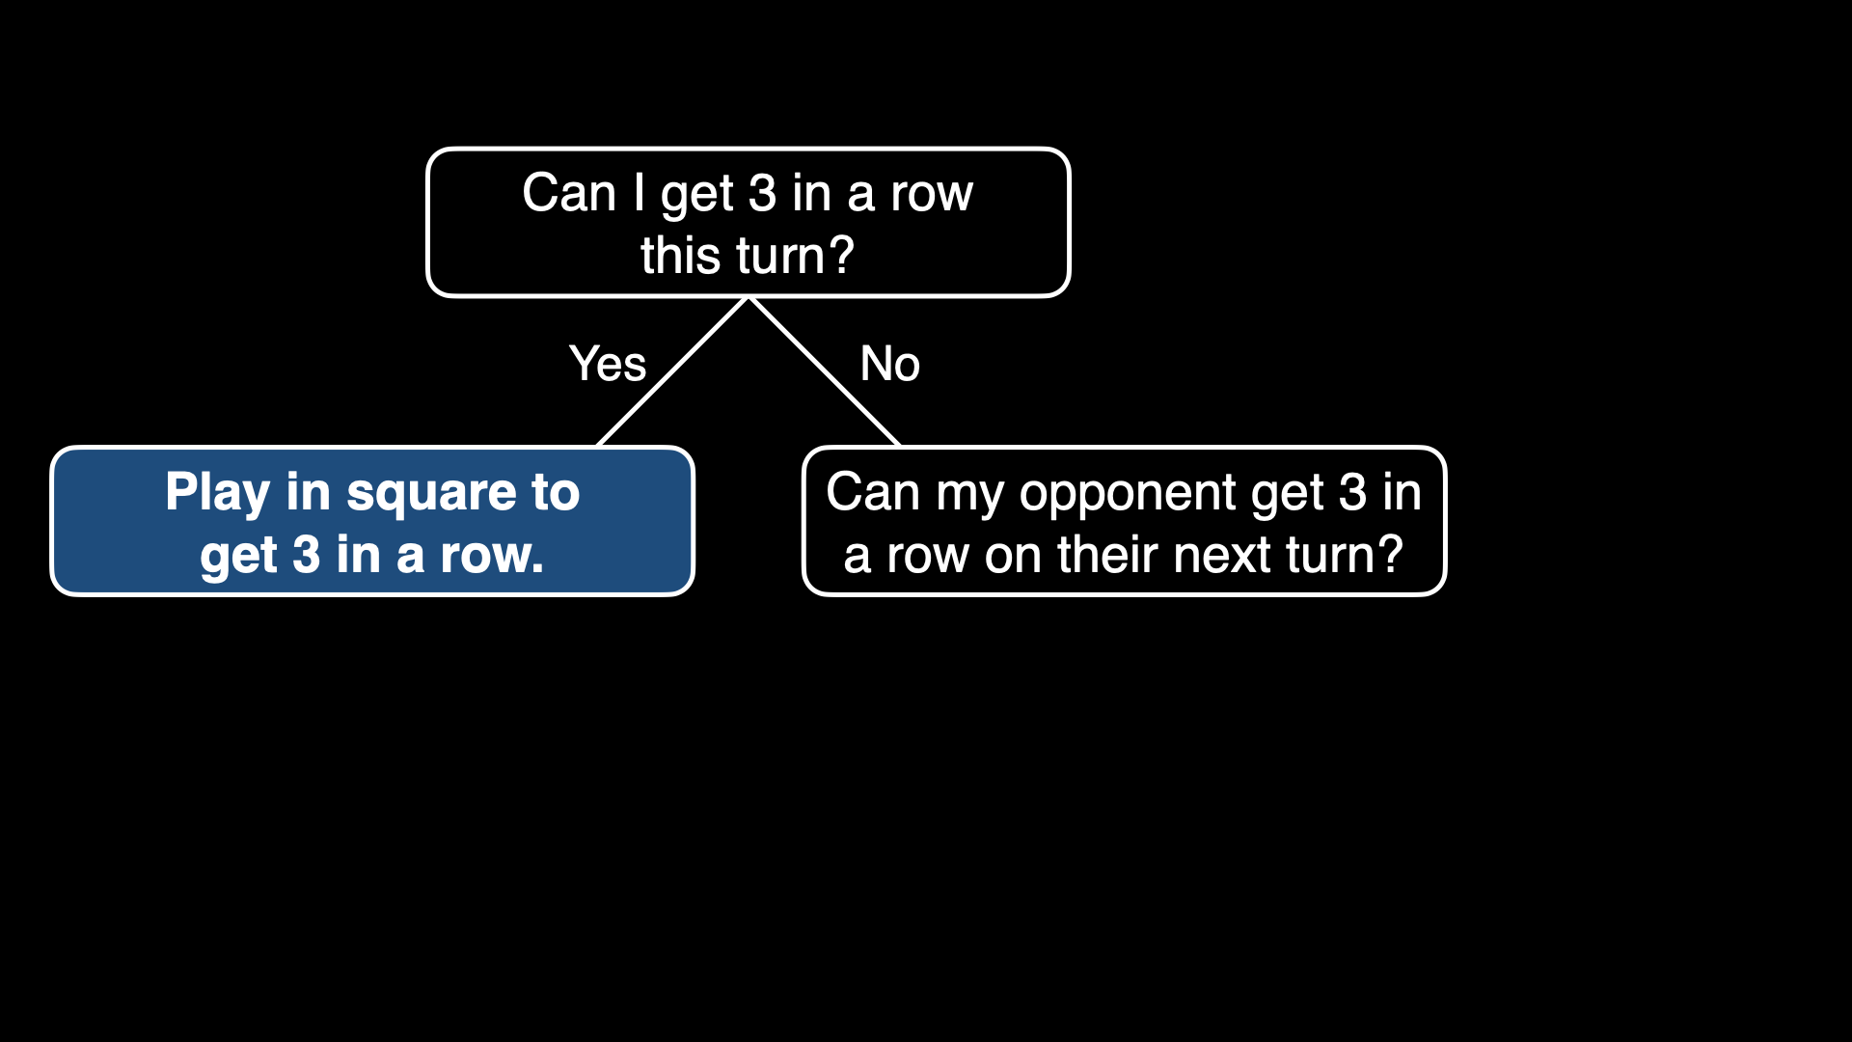

Slide 68
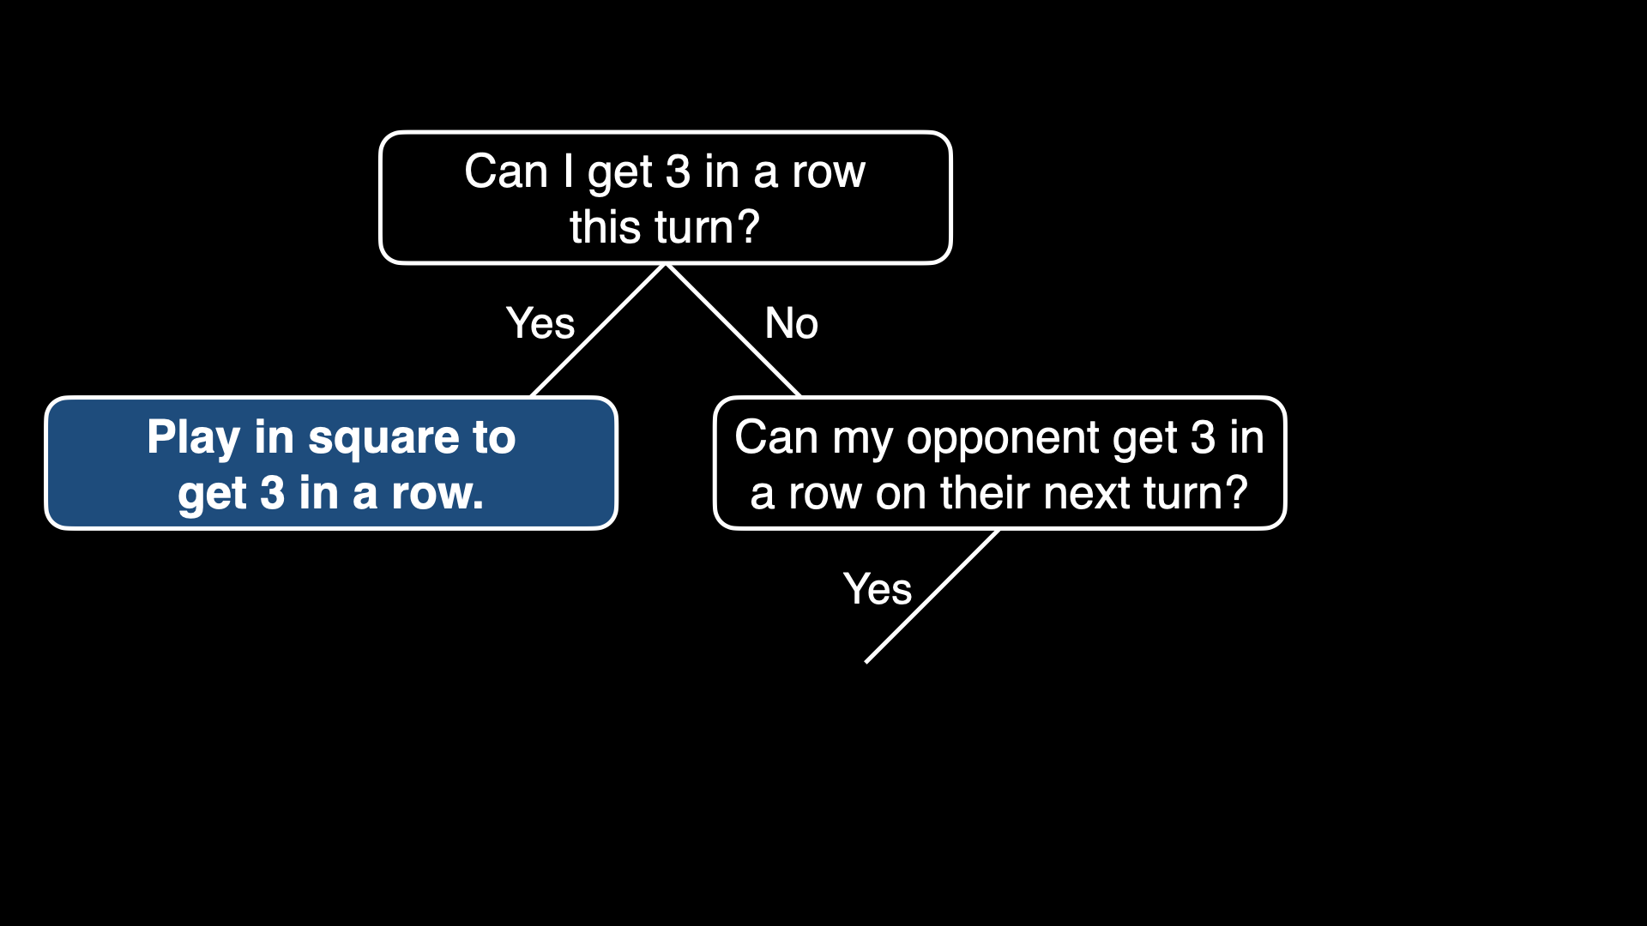

Slide 69
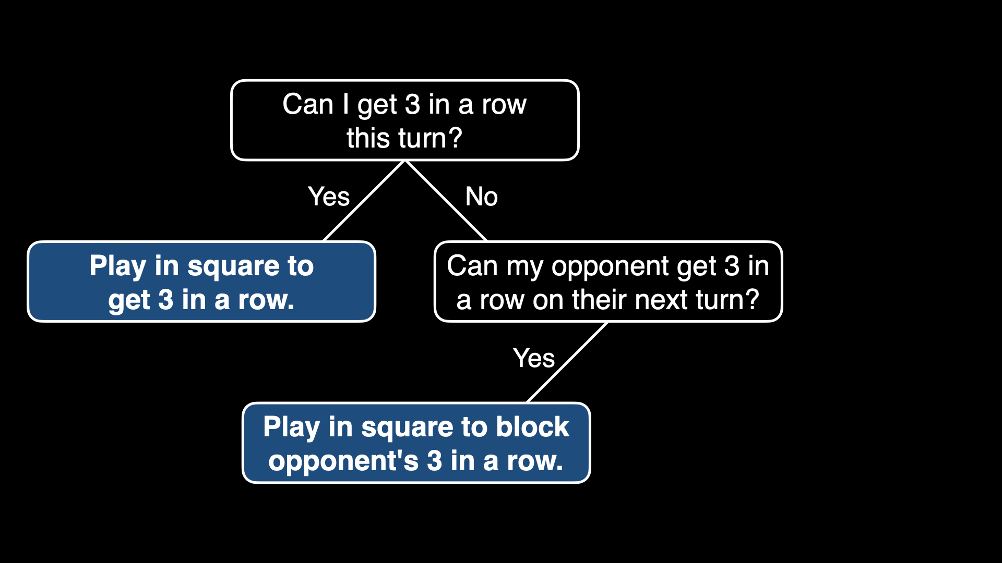

Slide 70
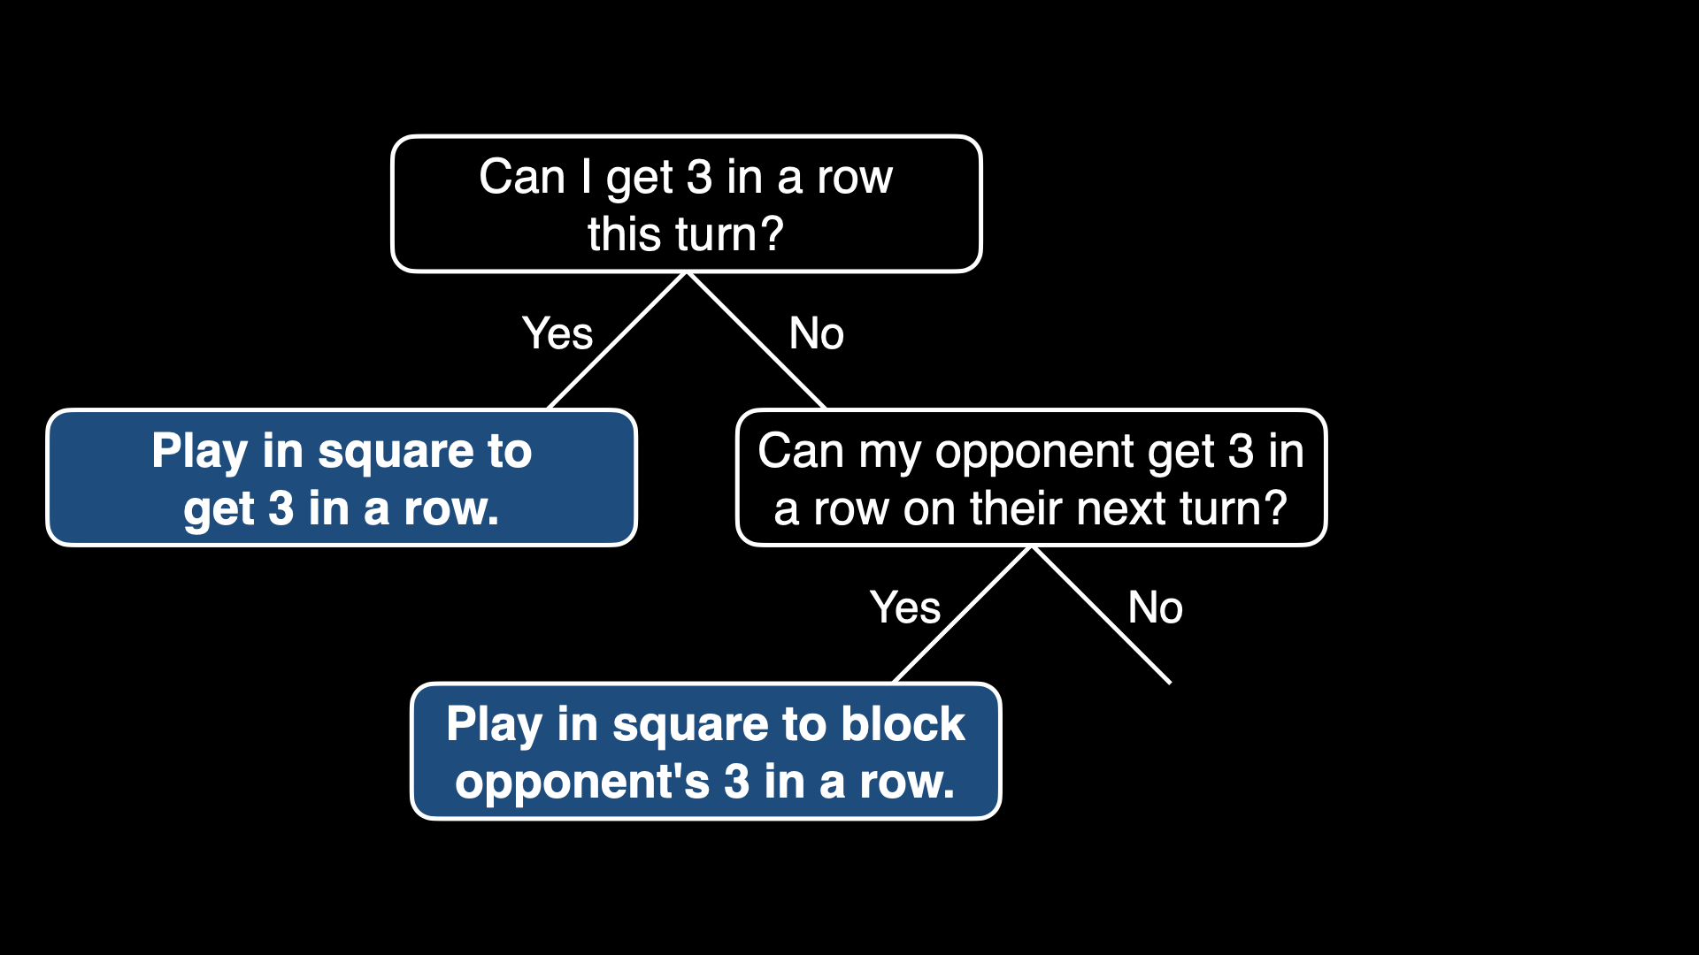

Slide 71
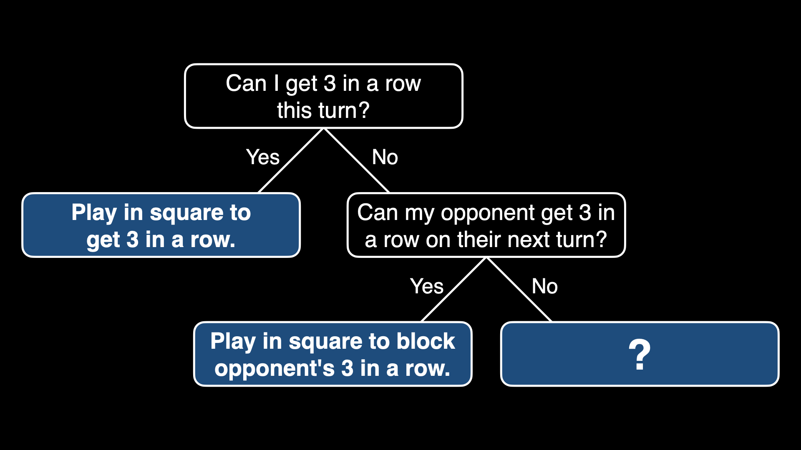

Slide 72
Notes:
O's turn

Slide 73


Slide 74
minimax

Slide 75
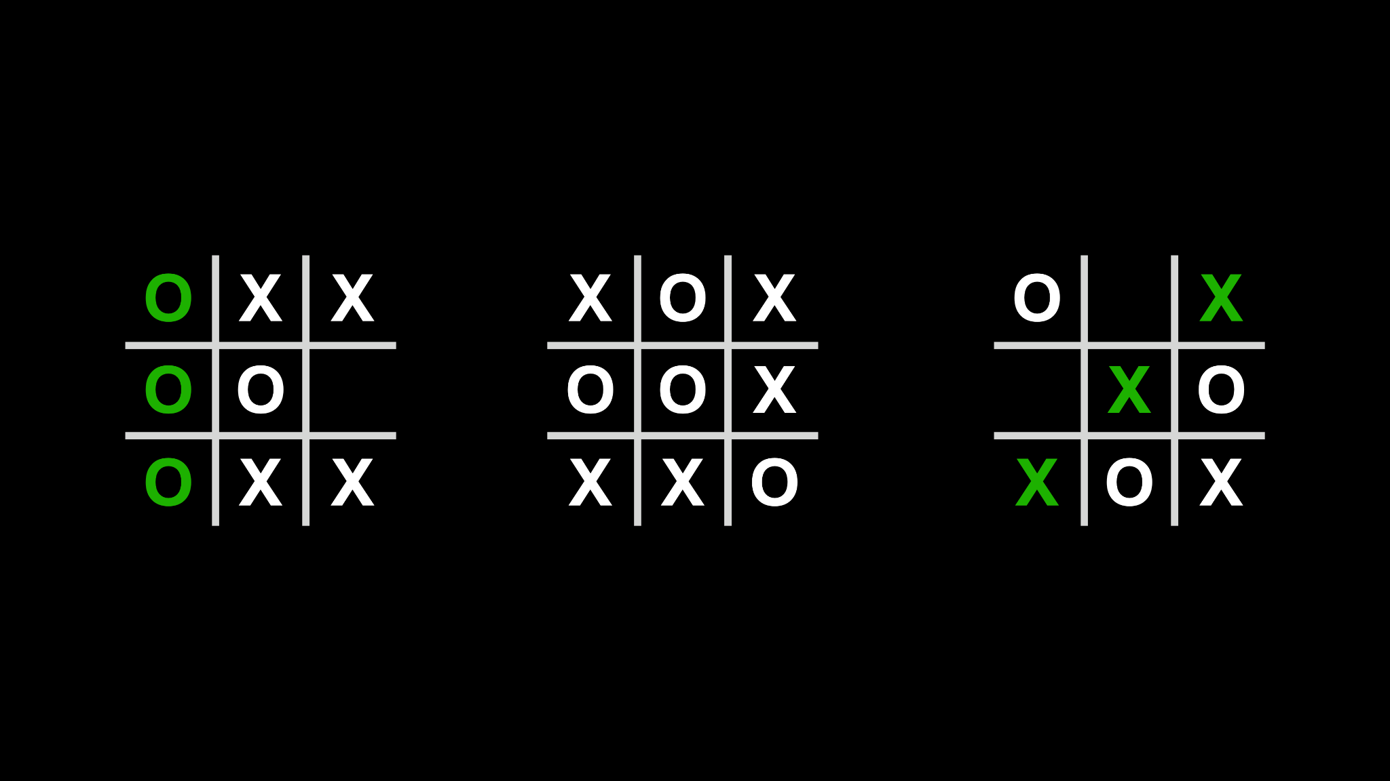

Slide 76
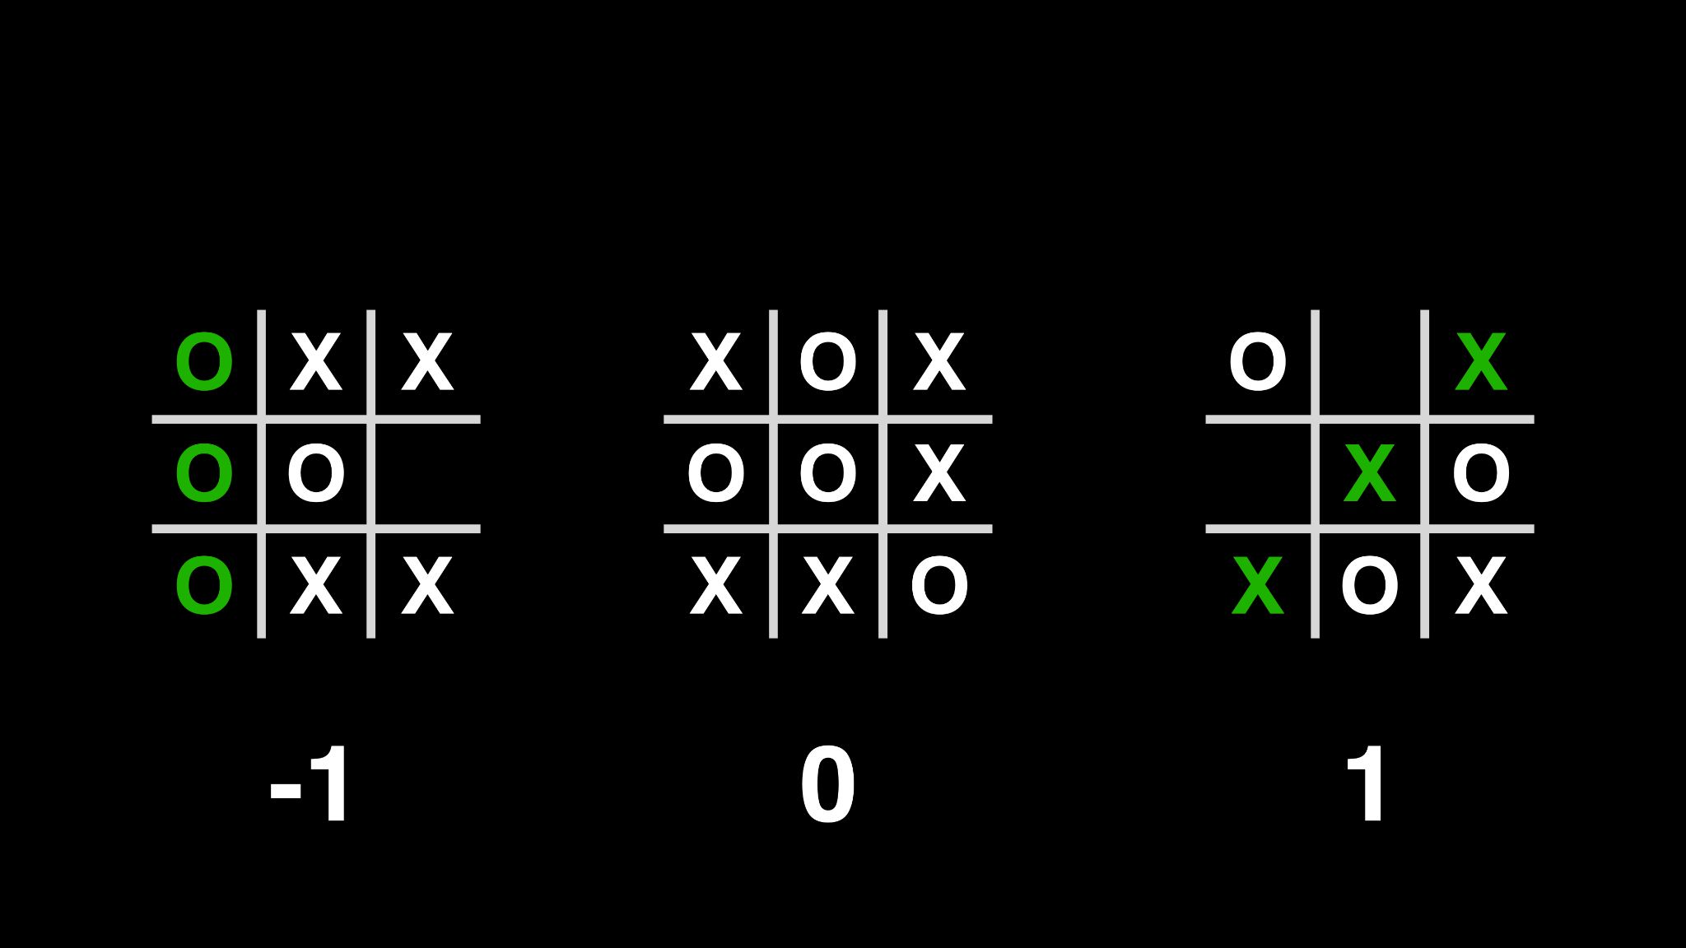

Slide 77
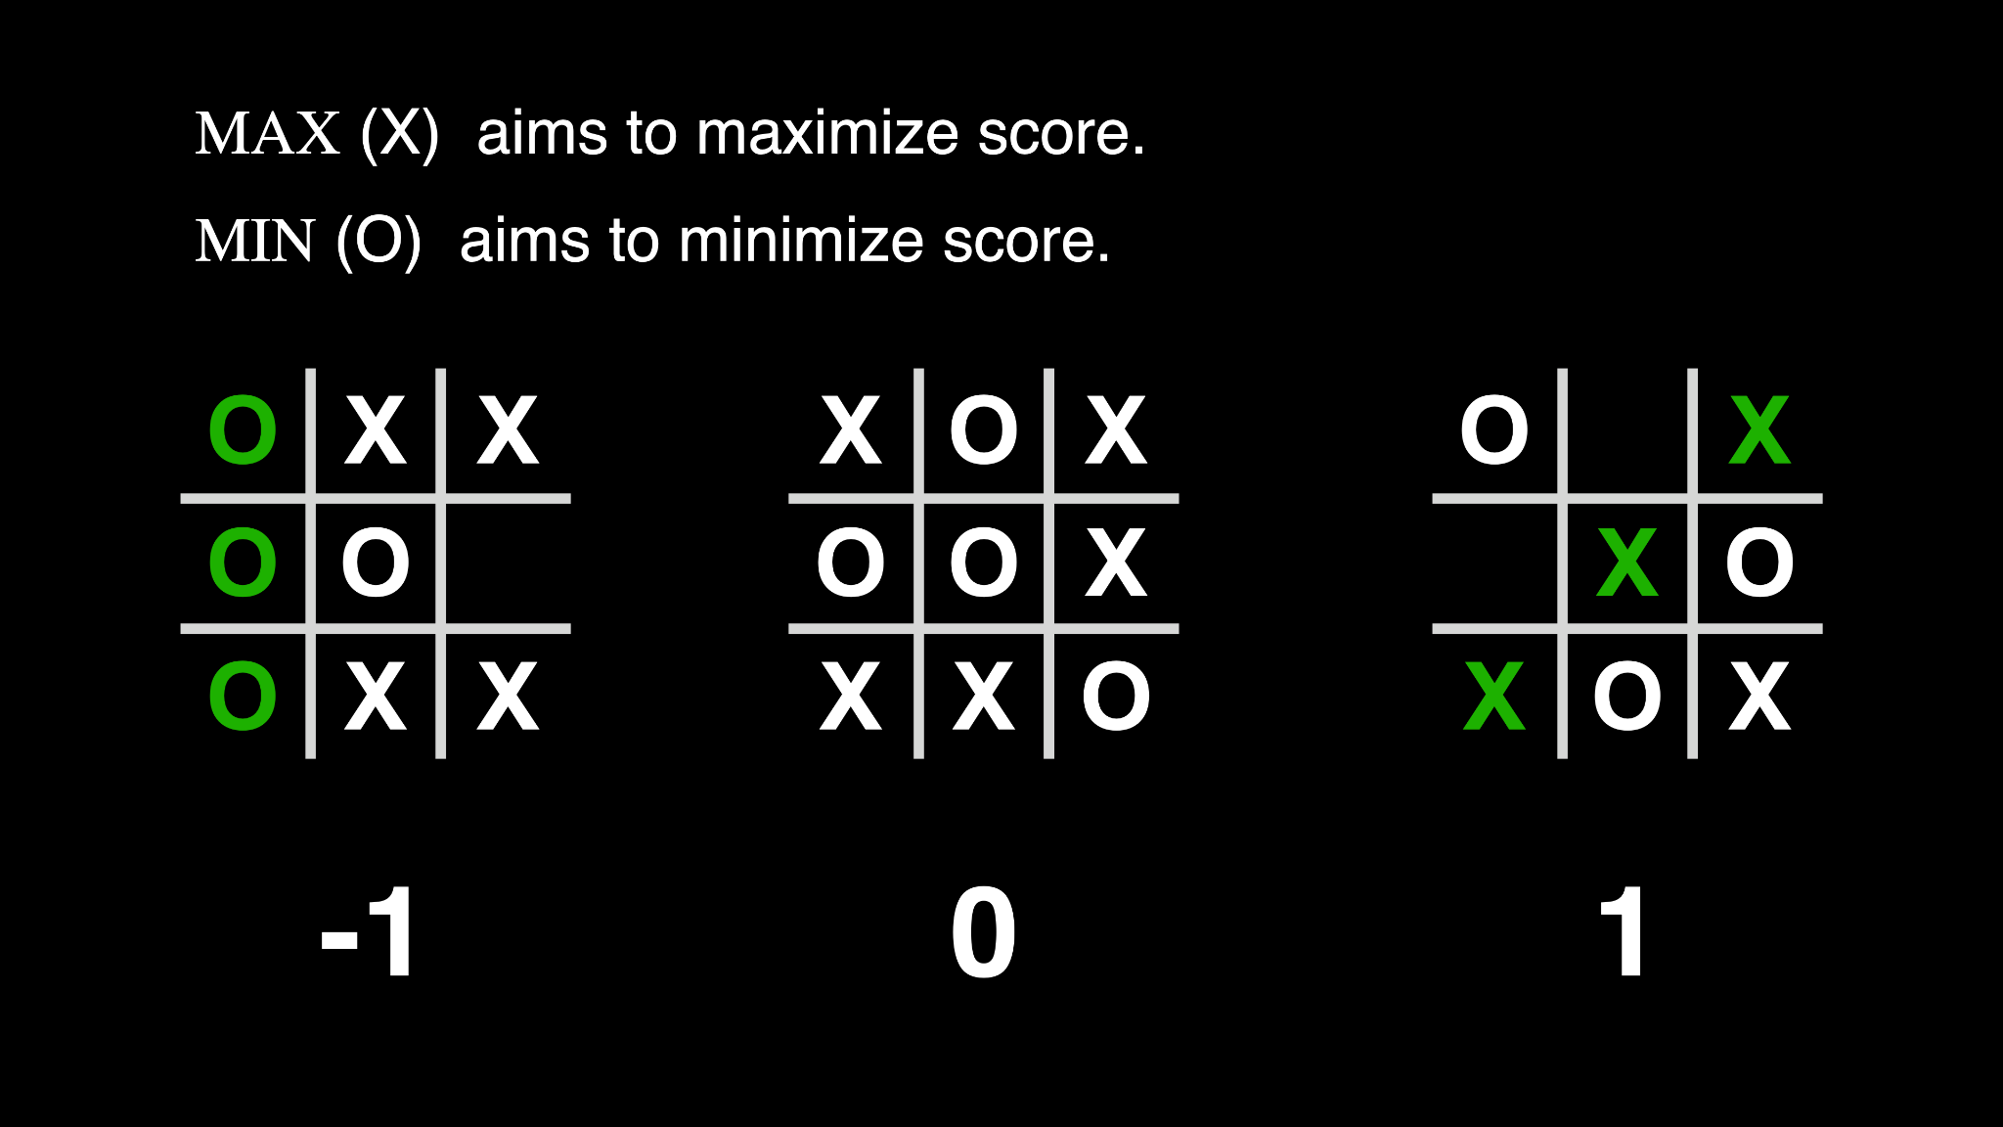

Slide 78


Slide 79


Slide 80


Slide 81
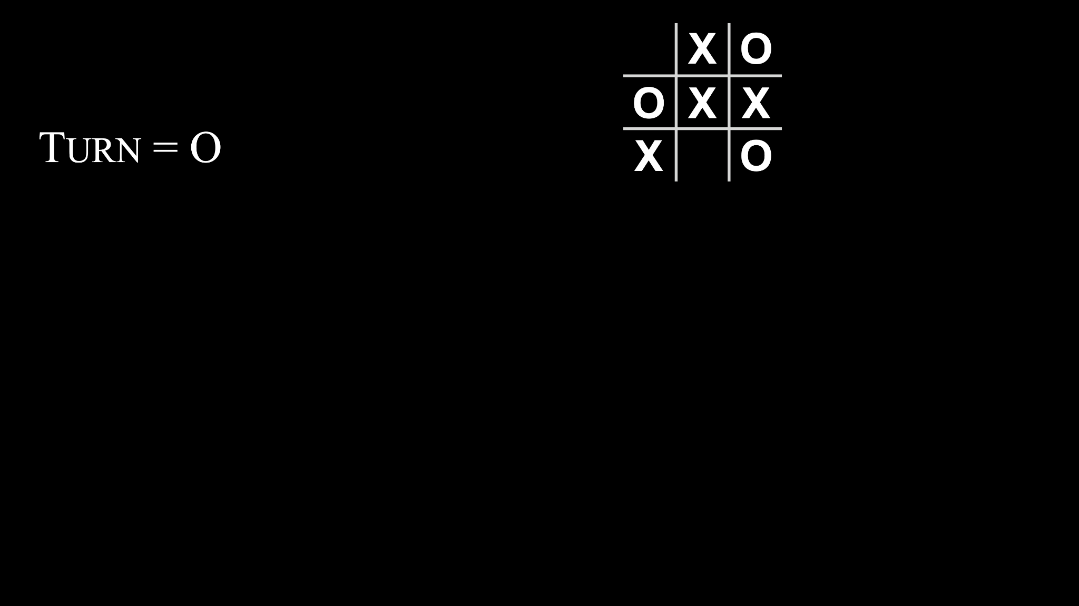

Slide 82
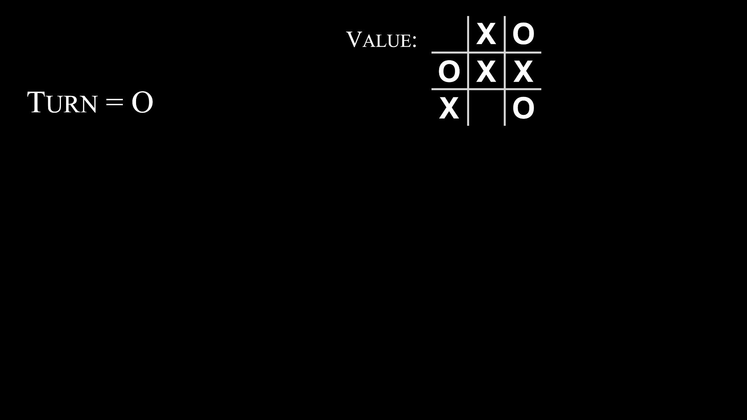

Slide 83
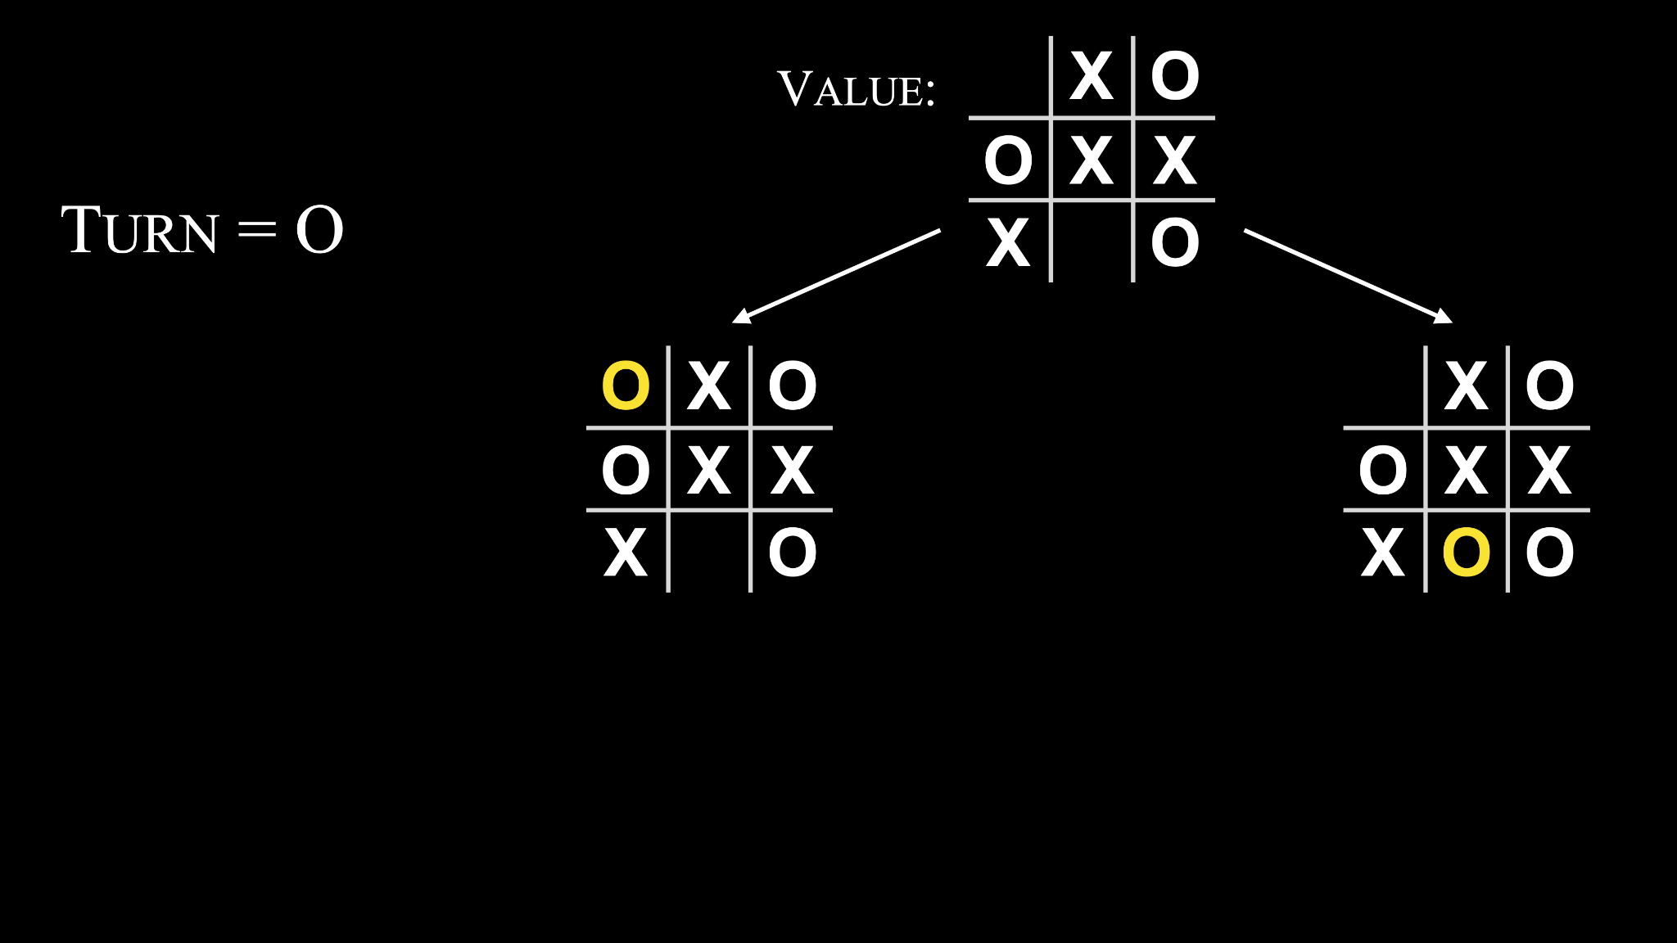

Slide 84
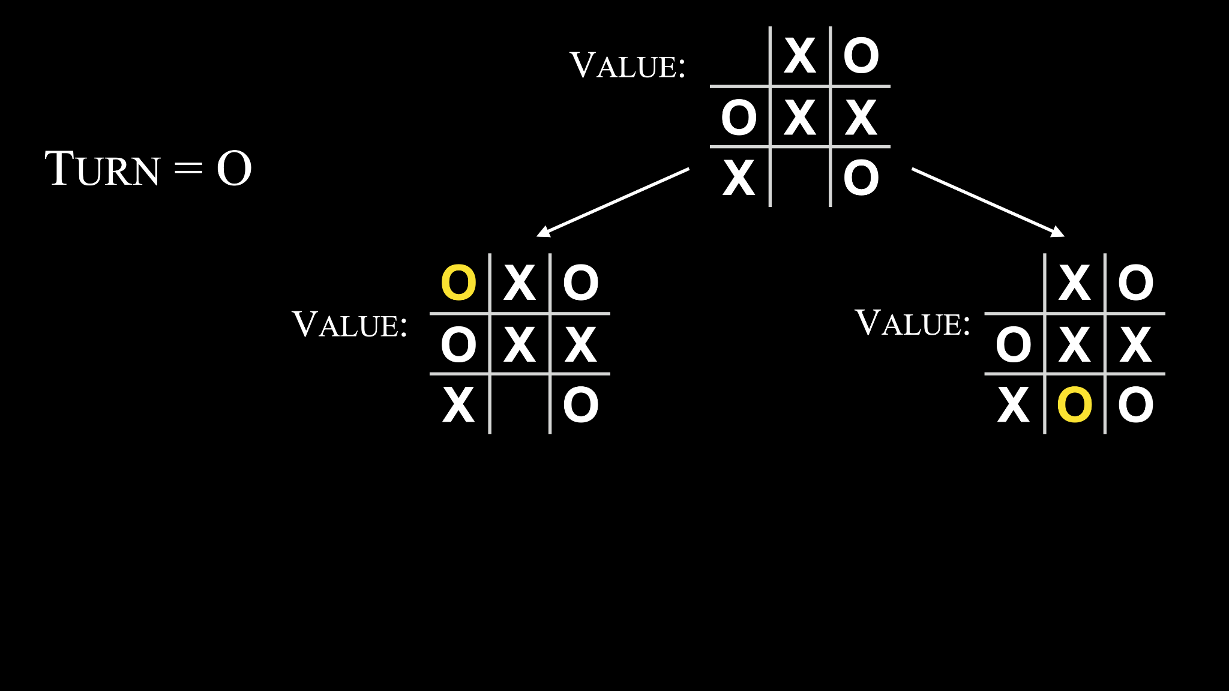

Slide 85
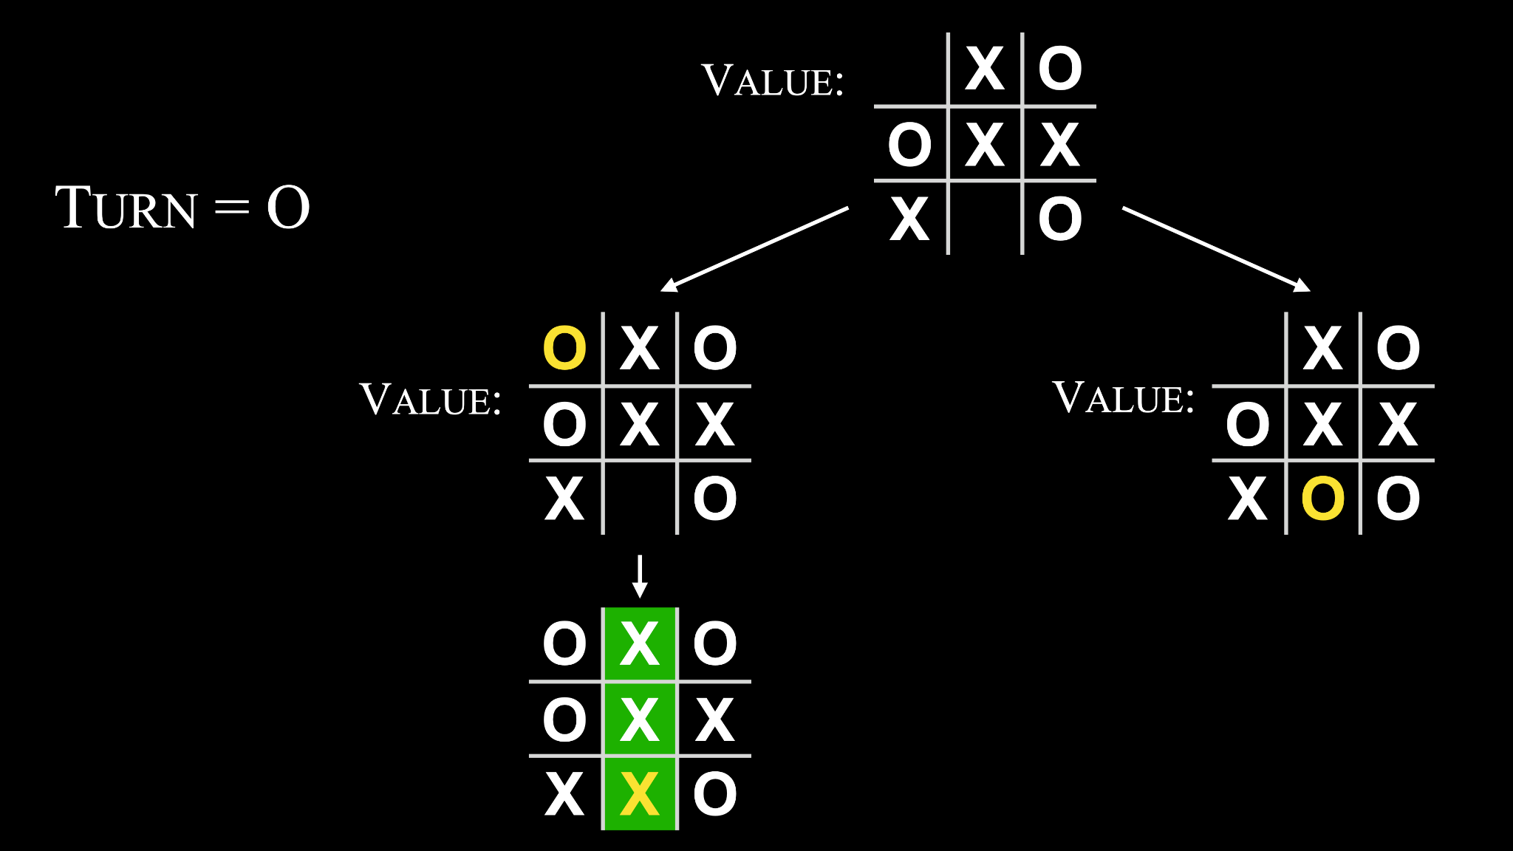

Slide 86
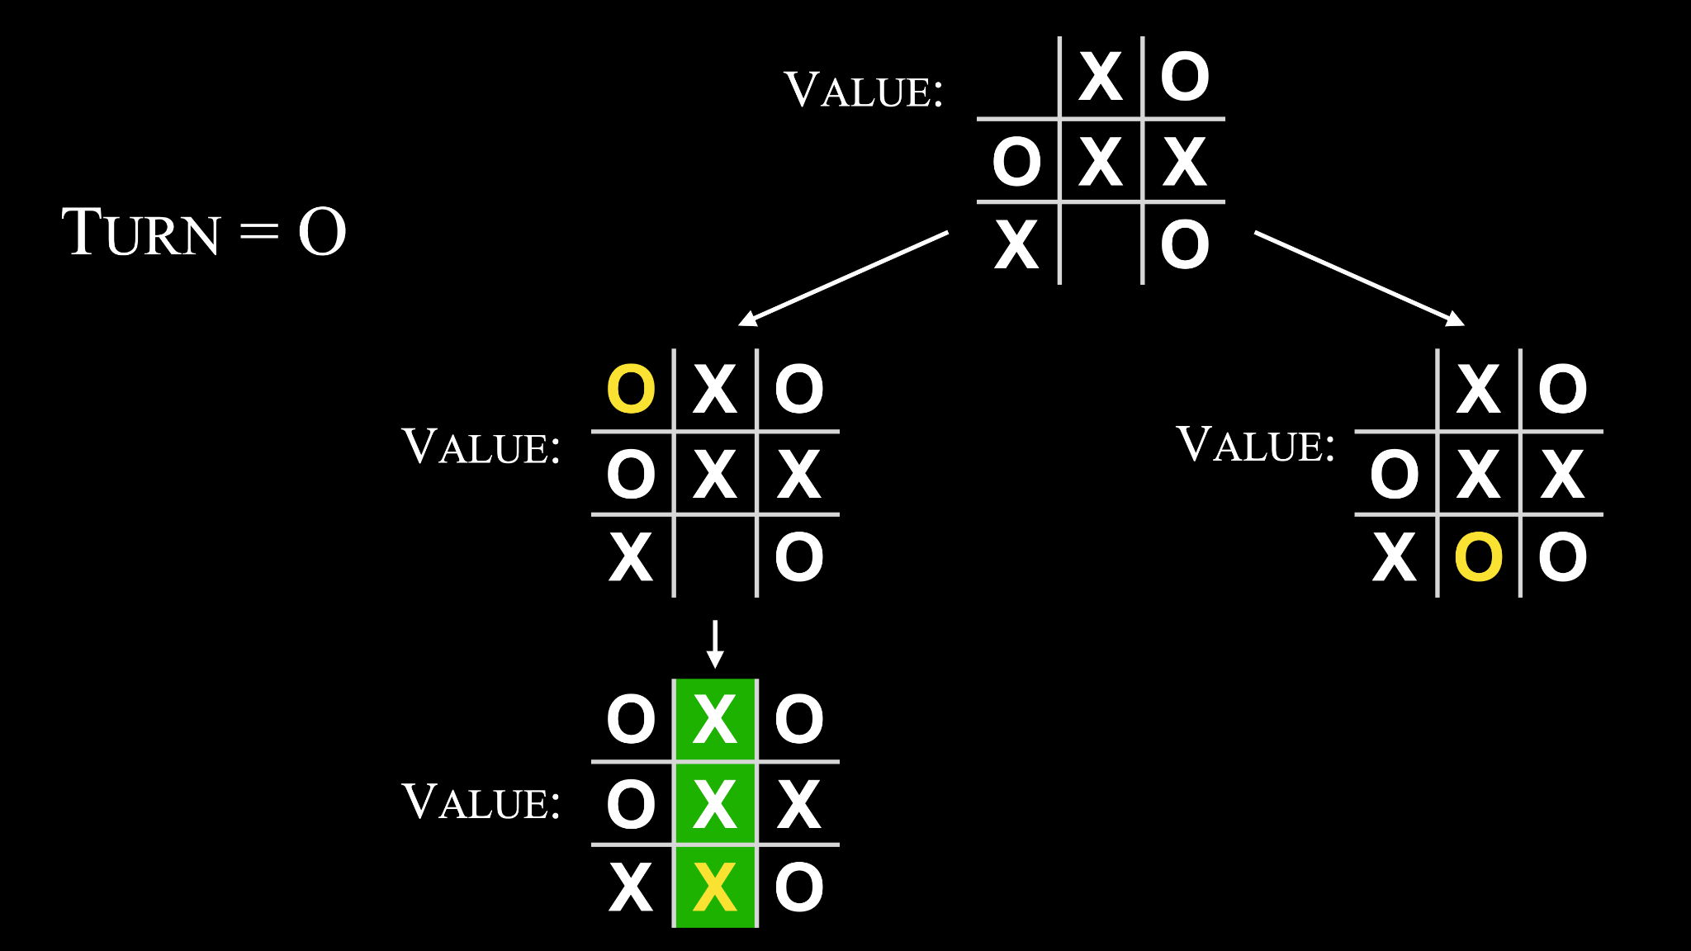

Slide 87


Slide 88


Slide 89
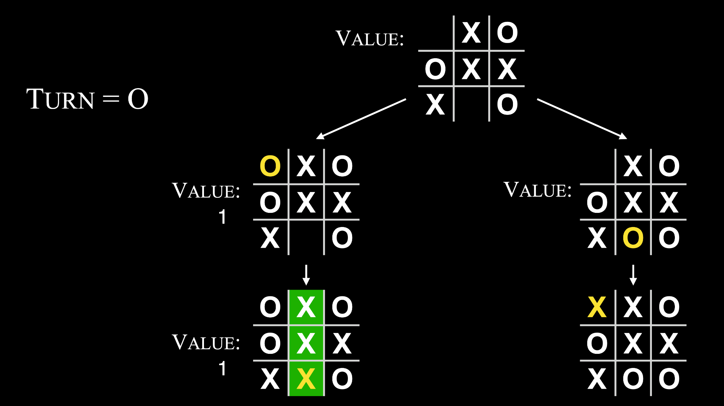

Slide 90
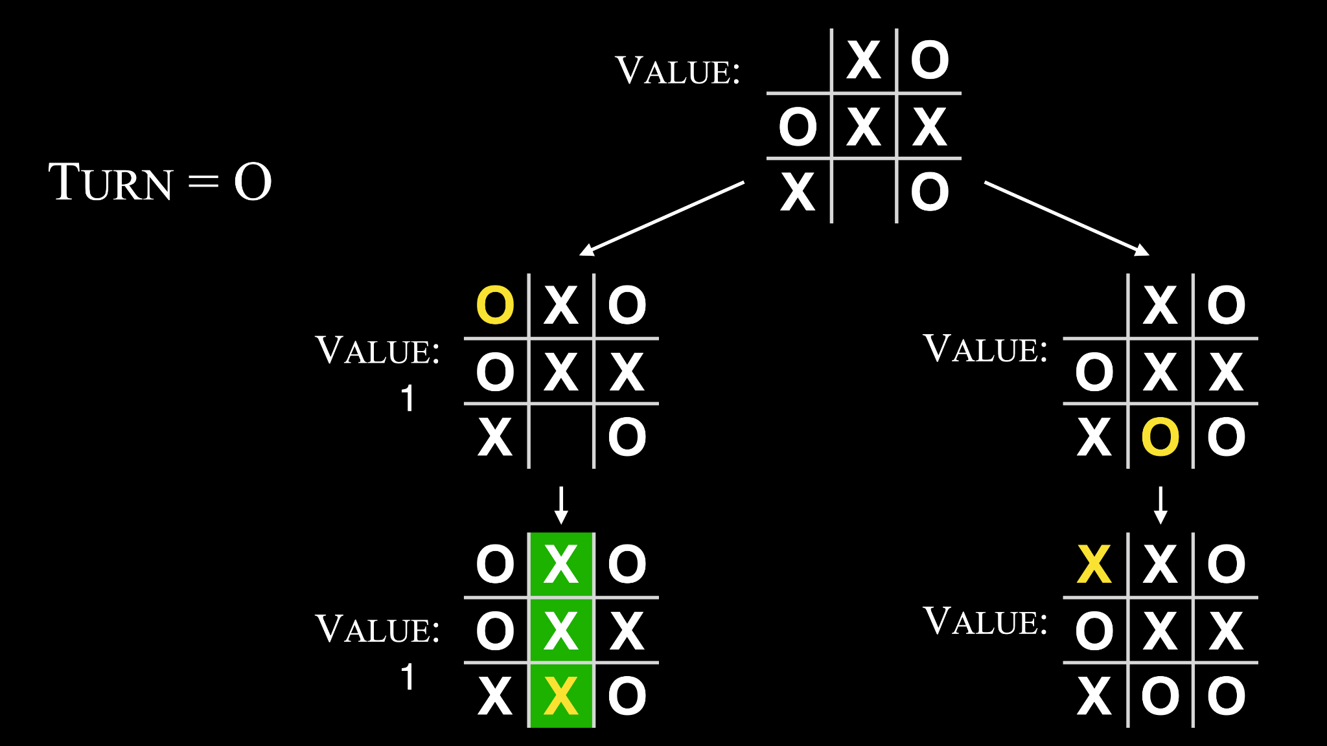

Slide 91


Slide 92


Slide 93


Slide 94
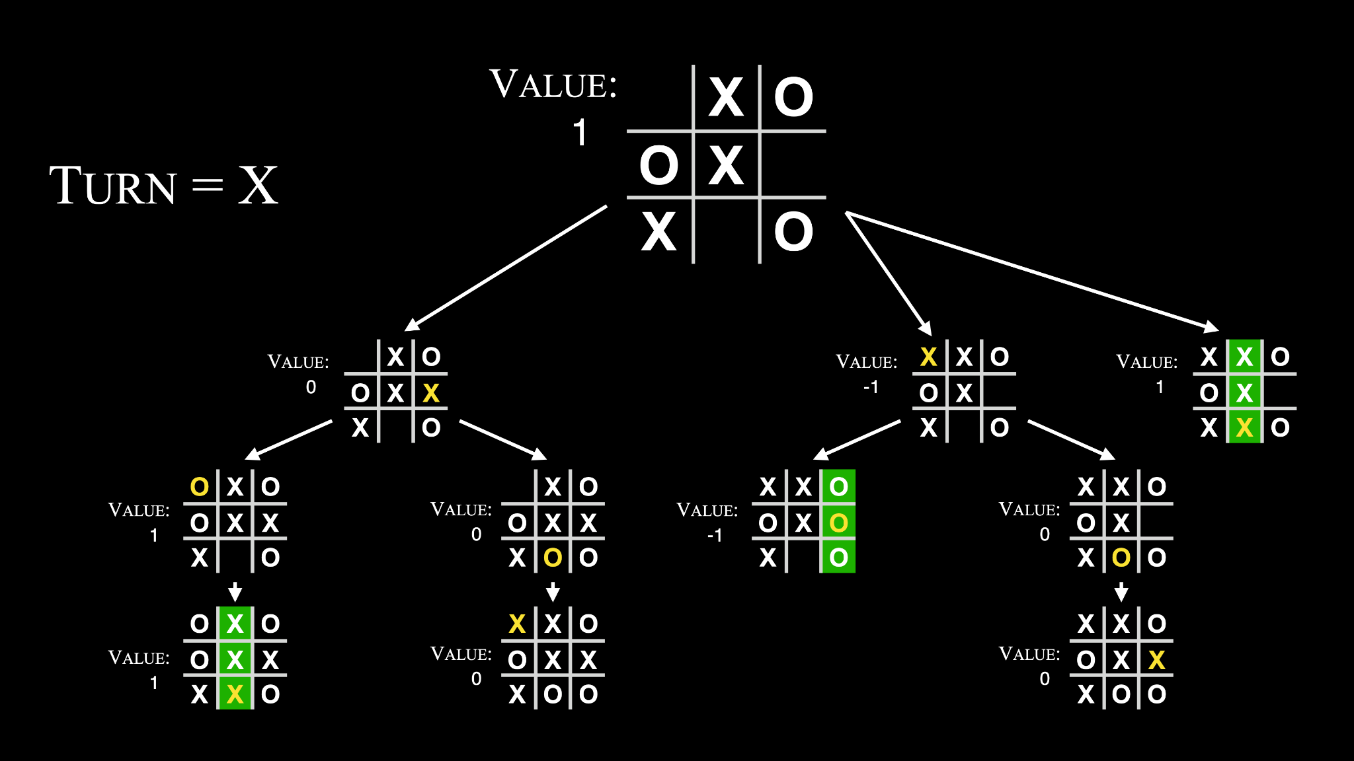

Slide 96
If player is X: For each possible move:
Calculate score for board
Choose move with highest score

Slide 97
If player is X: For each possible move:
Calculate score for board
Choose move with highest score
Else if player is O:
For each possible move:
Calculate score for board
Choose move with lowest score

Slide 98
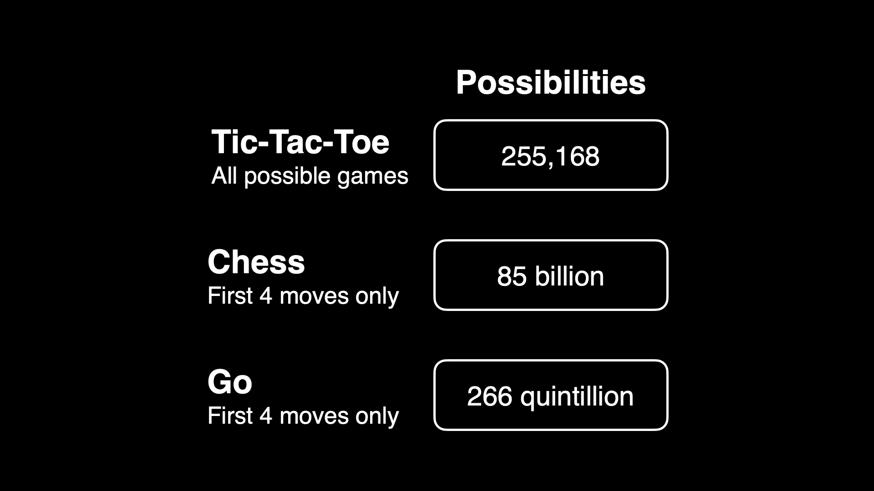

Slide 103
machine learning

Slide 104
reinforcement learning
Notes:
AI learns to make decisions by maximizing reward function

Slide 105

Notes:
https://emojipedia.org/google/15.0/pancakes

Slide 106
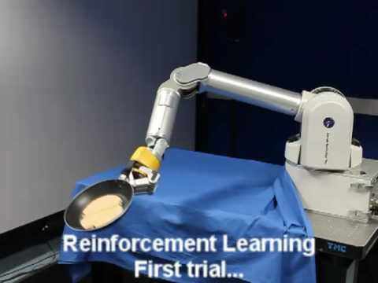
Notes:
https://www.youtube.com/watch?v=W_gxLKSsSIE

Slide 107
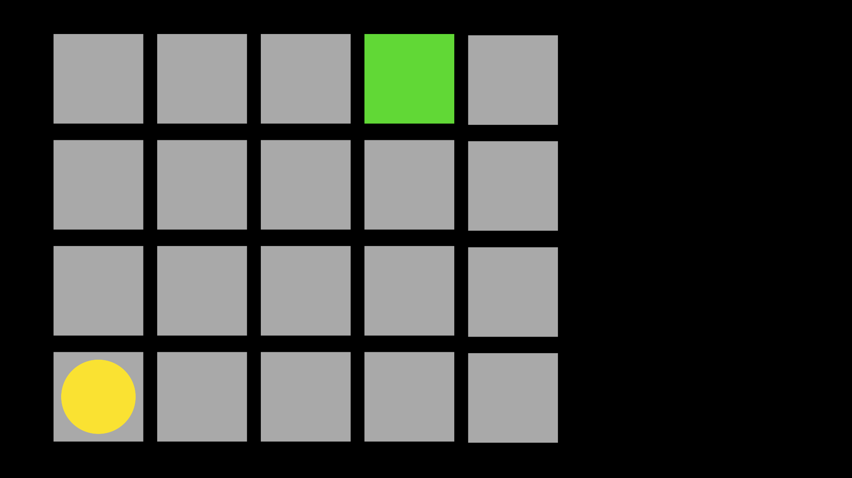

Slide 108
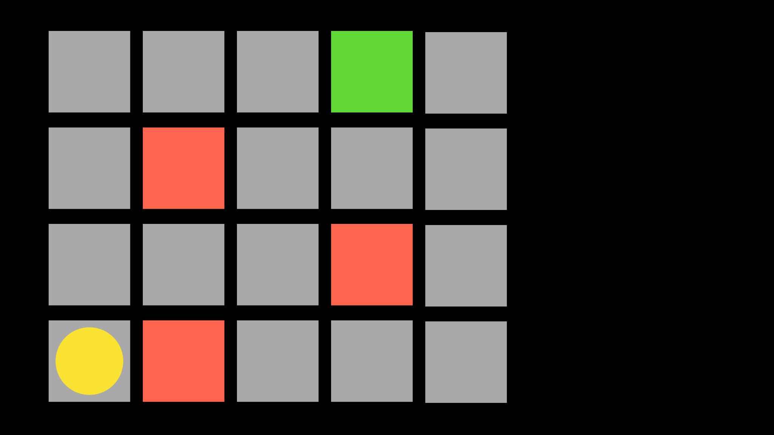

Slide 109
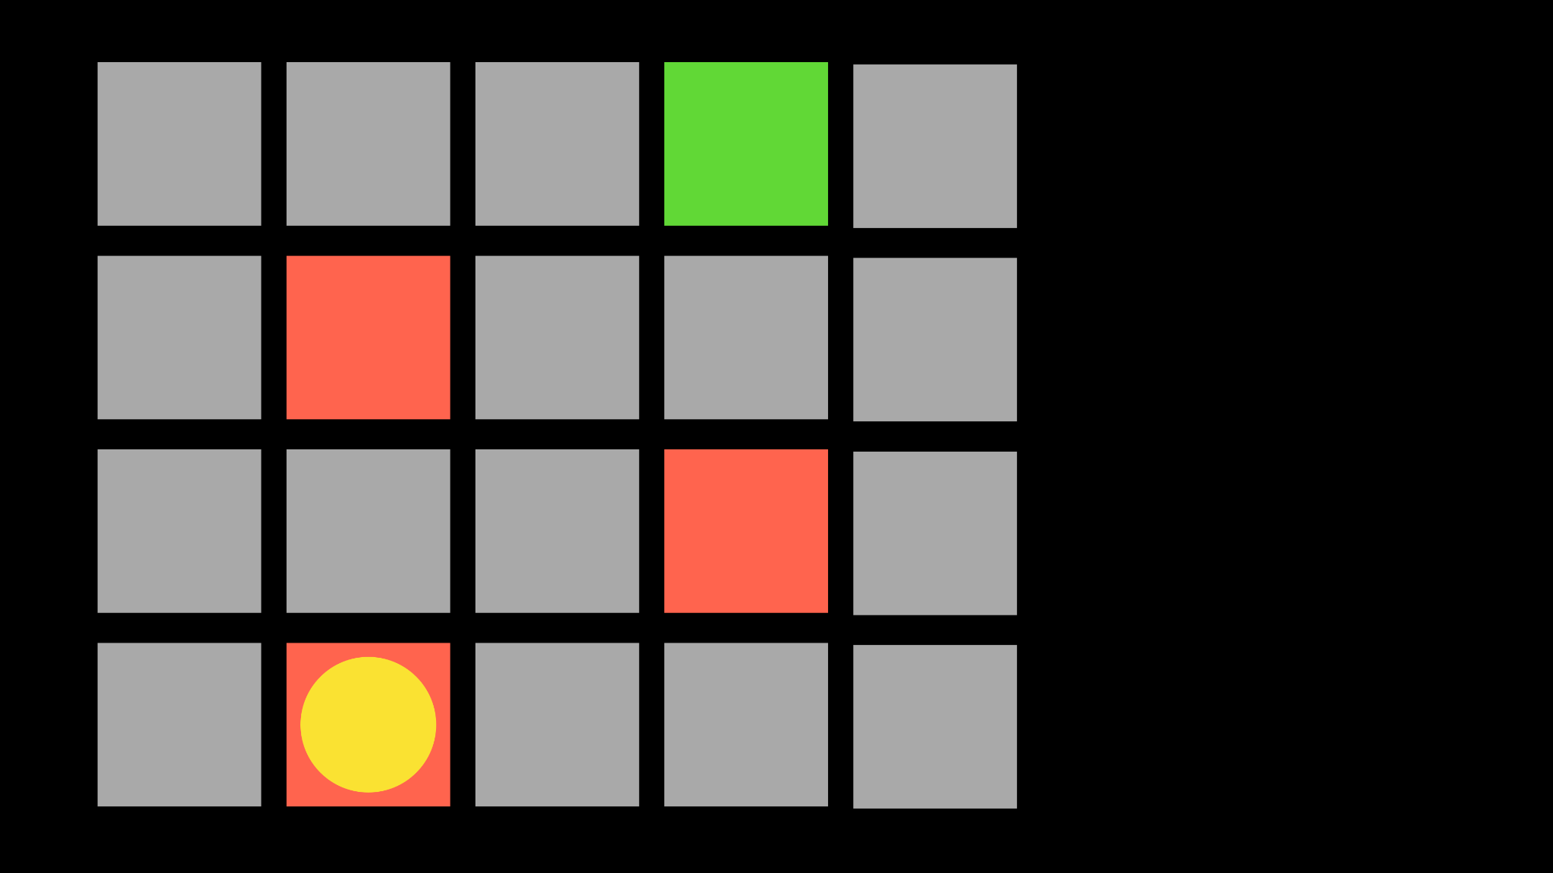

Slide 110


Slide 111
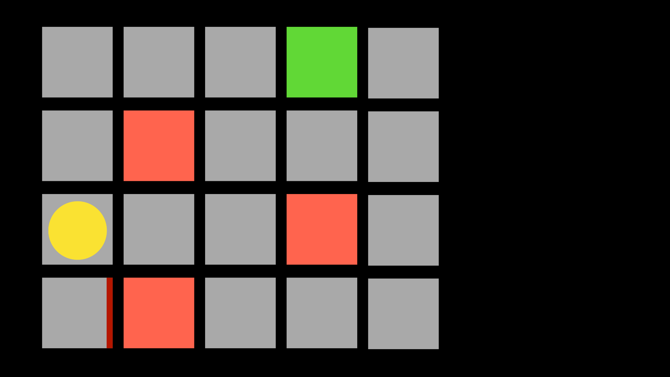

Slide 112
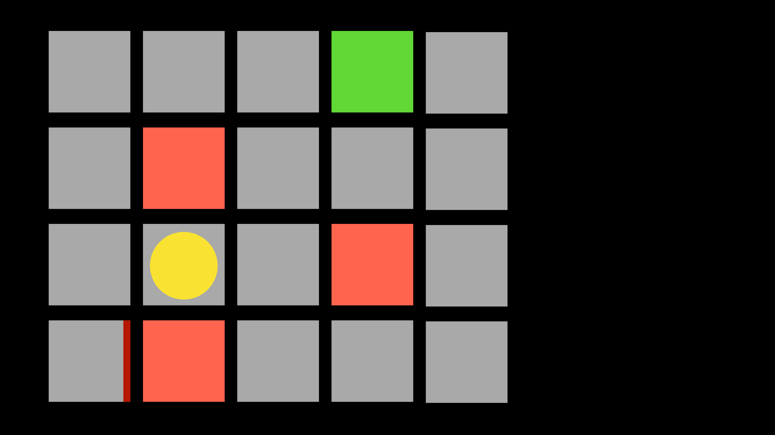

Slide 113
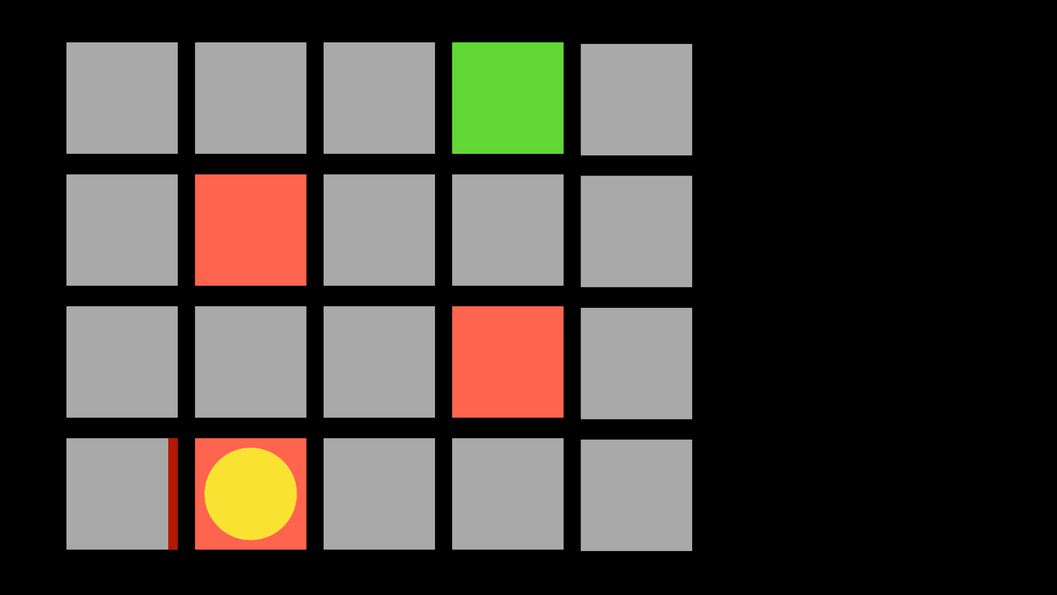

Slide 114
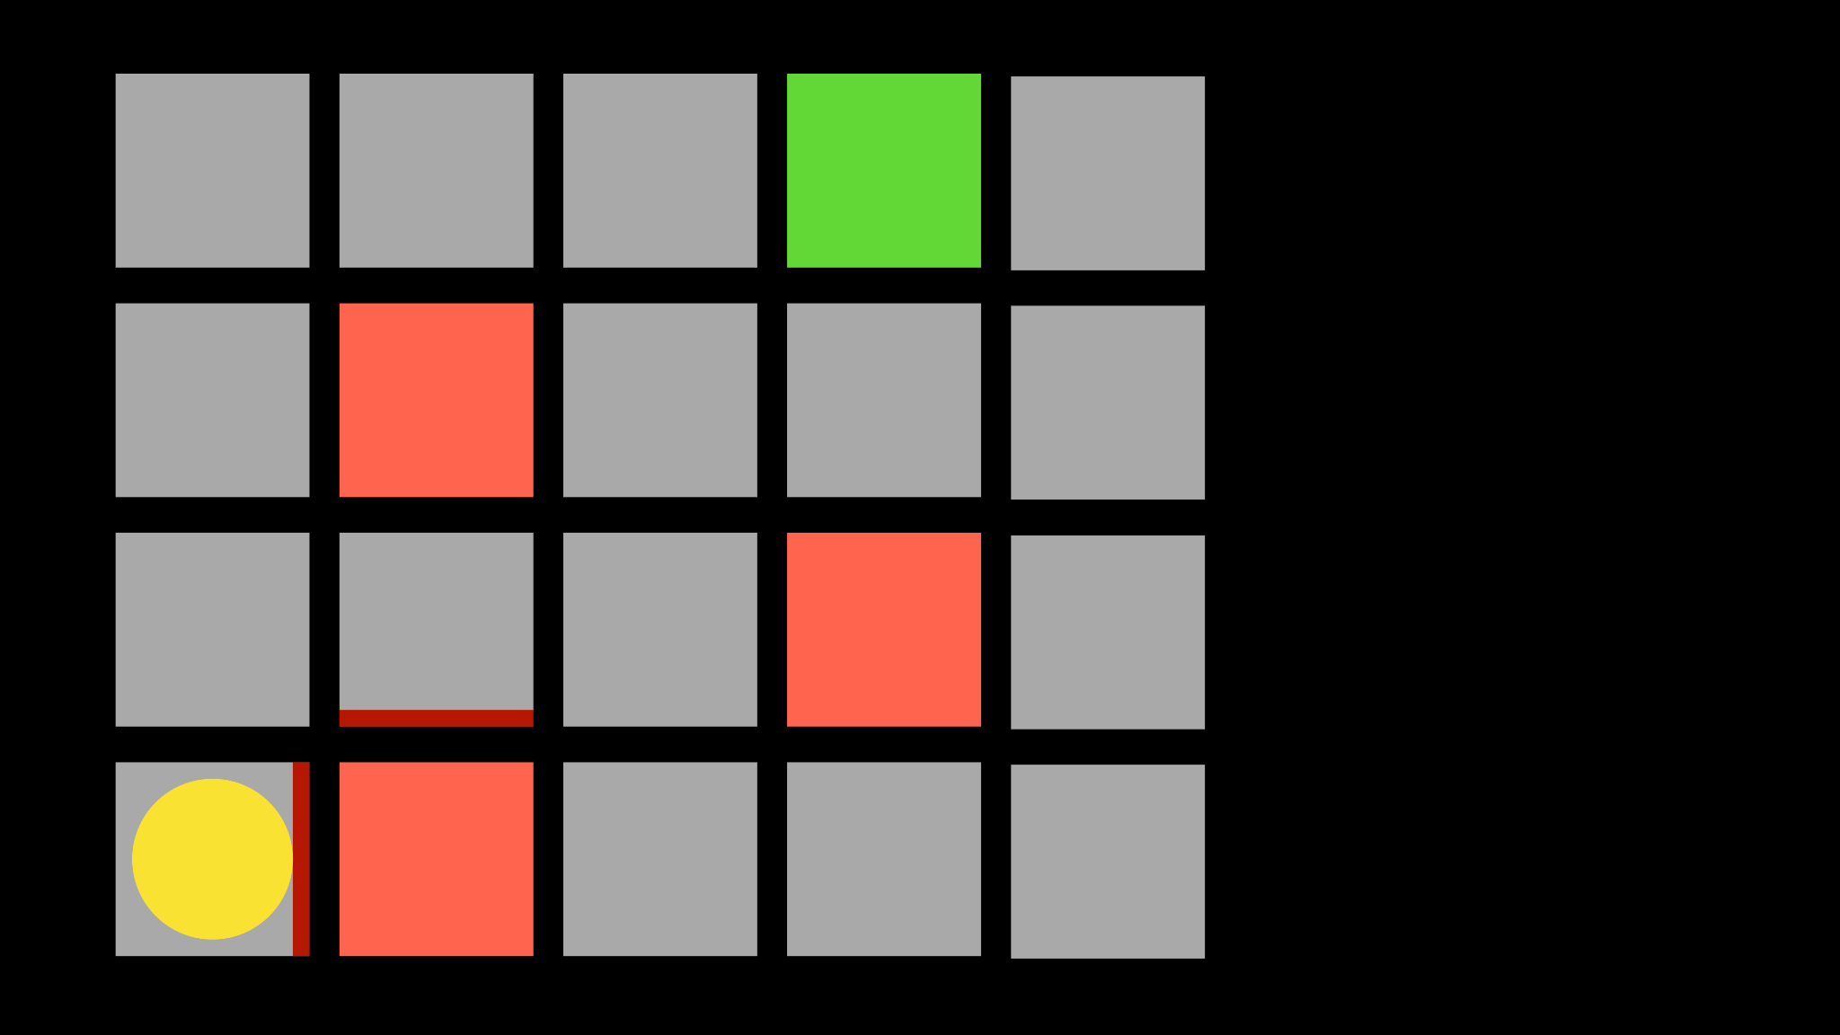

Slide 115


Slide 116


Slide 117


Slide 118


Slide 119


Slide 120


Slide 121


Slide 122


Slide 123


Slide 124


Slide 125


Slide 126


Slide 127


Slide 128


Slide 129


Slide 130


Slide 131


Slide 132


Slide 133


Slide 134


Slide 135


Slide 136


Slide 137


Slide 138


Slide 139


Slide 140


Slide 141


Slide 142


Slide 143


Slide 144


Slide 145
explore vs. exploit
Notes:
epsilon

Slide 146
epsilon = 0.10
If random() < epsilon:
Make a random move
Else:
Make the move with the highest value

Slide 147


Slide 148


Slide 149


Slide 150


Slide 151


Slide 152


Slide 153


Slide 154

Notes:
https://www.youtube.com/watch?v=Q70ulPJW3Gk

Slide 155
supervised learning
Notes:
labeled data

Slide 156


Slide 157
unsupervised learning
Notes:
unlabeled data, finding anomalies

Slide 158
deep learning
Notes:
inspired by the brain

Slide 159
neural networks

Slide 160


Slide 161


Slide 162


Slide 163


Slide 164


Slide 165


Slide 166


Slide 167


Slide 170


Slide 171


Slide 172


Slide 173
a
c
b

Slide 174
ax + by + c > 0
Notes:
if true, red; else blue

Slide 175


Slide 176


Slide 177


Slide 178
large language models
Notes:
neural network trained on lots of text

Slide 179

Notes:
attention: weight of importance

Slide 180
Generative Pre-trained Transformers
Notes:
neural network trained on lots of text

Slide 181
Generative Pre-trained Transformers
Notes:
neural network trained on lots of text

Slide 182
"Massachusetts is a state in the New England region of the Northeastern United States. It borders on the Atlantic Ocean to the east. The state's capital is…"

Slide 183
"Massachusetts is a state in the New England region of the Northeastern United States. It borders on the Atlantic Ocean to the east. The state's capital is…"

Slide 184


Slide 187
[-0.0008102366, 0.013022771, -0.0055872737, -0.04236497, -0.02812971, 0.029492939, -0.009463957, 0.007963094, -0.003876683, -0.015795108, 0.0065605408, -0.0010248796, 0.014890658, -0.009182136, 0.00007839182, -0.010853401, 0.027605392, -0.022086935, -0.0042863074, -0.01765644, -0.00028120697, 0.03350398, -0.0017744919, -0.00441411, 0.0055610575, -0.0026461722, 0.002932909, -0.019045886, -0.010381515, -0.019150749, 0.022414634, -0.030751305, -0.037043132, -0.046769246, -0.0072421553, 0.000565691, -0.0049285977, -0.0035162137, 0.021182485, -0.030882385, 0.013959992, 0.011417044, -0.00638686, -0.02632081, -0.0018482242, 0.0048401193, -0.009221459, 0.0009232929, -0.01624078, -0.00077746663, 0.01895413, 0.02697621, -0.031223193, 0.0028509842, -0.0046074525, -0.011043468, 0.0075960704, 0.0036112466, -0.010840294, -0.00020972757, -0.004427218, 0.014916874, -0.03473613, 0.009201797, 0.010892726, -0.019609528, 0.006796484, 0.027605392, -0.0027936369, -0.0065834797, 0.020671275, 0.029912395, 0.023646783, -0.012006903, 0.008159713, -0.009326323, -0.0046140067, -0.0075305304, -0.0075501925, 0.013147297, 0.022558821, -0.01624078, -0.032507773, 0.013527429, 0.016332535, 0.0017302524, -0.010591242, 0.021326672, 0.008343225, -0.014746469, 0.0090969335, 0.027815118, -0.0003426506, 0.010329083, -0.0028755616, -0.0029607634, -0.0034768898, 0.03292723, -0.019897902, -0.018639538, 0.0051809265, 0.015375652, -0.017197661, -0.015467408, -0.020553302, -0.0037161105, -0.0100275995, -0.0108730635, -0.00039262476, -0.020487761, -0.011050021, -0.010453609, 0.010787862, -0.045563314, -0.012603316, 0.0052497433, -0.008146605, -0.011980687, 0.0032245615, -0.013435672, 0.03588963, -0.003170491, -0.0056691985, 0.01565092, 0.041866865, -0.012786828, -0.005374269, -0.0041224575, -0.0018613322, -0.0005124398, 0.017813735, -0.009306661, 0.001985858, 0.009739224, -0.011122115, 0.029545372, -0.038956895, -0.00983098, -0.0190721, -0.02561298, -0.009339431, 0.023659892, -0.0054693017, 0.013376687, 0.004427218, 0.009994829, 0.0066031413, 0.0038144202, 0.015428084, -0.02586203, 0.008022079, -0.02392205, 0.021772344, 0.015113493, 0.015270789, -0.0065113856, 0.017695764, 0.018927913, -0.0053054523, -0.0056462595, -0.024459478, 0.010040708, 0.015782, -0.00989652, 0.0025036228, 0.014785794, -0.0015672221, -0.0041257343, 0.011829946, -0.0038242512, -0.0038013123, 0.01700104, -0.032507773, 0.002025182, 0.008310455, 0.013724048, 0.00044485184, 0.030987248, -0.024367722, -0.012000349, 0.010256989, 0.017053474, 0.0008806919, 0.02224423, -0.0049974145, 0.011764406, 0.030672656, -0.0067080054, 0.017708872, -0.023463272, 0.014864442, 0.035339095, 0.010427393, -0.010119355, -0.6820341, -0.020881, 0.004047087, -0.005246466, -0.016149024, -0.0056724753, 0.010499487, 0.012426359, -0.023620568, 0.004391171, -0.013658508, 0.030934816, -0.0006754702, -0.024328398, -0.0019022946, -0.01642429, -0.0003072181, -0.03258642, 0.003457228, 0.006717836, -0.005400485, -0.0015205248, 0.00082580233, 0.016463615, 0.021169377, 0.007366681, 0.011731636, 0.012747504, -0.041499842, -0.008690586, -0.023686107, 0.006881686, 0.011561233, 0.013474996, 0.03549639, -0.0065572634, -0.025980003, 0.019779932, 0.012852368, 0.022086935, -0.0037652652, 0.0030459652, 0.02288652, 0.006816146, -0.008769234, -0.004725424, 0.019832363, -0.0042011053, 0.016948609, -0.017079689, 0.0050629545, 0.008212145, -0.013566752, 0.005308729, -0.01953088, -0.0076943804, 0.02198207, 0.003496552, 0.008605384, 0.012511561, -0.011849607, -0.0015090554, -0.030436713, -0.04690033, -0.01066989, -0.0037193873, -0.0037226644, 0.0045779594, -0.008657816, 0.00086840324, 0.020749921, 0.004070026, -0.013894452, -0.010945157, 0.025141092, 0.0060788225, 0.0069210096, -0.0056102127, -0.0075633004, -0.015375652, 0.0027887214, -0.006458954, -0.015323221, -0.00082457345, 0.025796492, -0.022388417, -0.009293553, 0.002854261, 0.009739224, 0.013842019, 0.019543989, 0.007877892, -0.017079689, -0.007812352, -0.011502246, -0.003434289, -0.008913422, 0.026268378, 0.017564684, -0.008906867, -0.00344412, -0.0051317713, 0.003362195, 0.0052300813, 0.009214905, -0.0056233206, 0.0015418254, 0.0082318075, 0.0333729, -0.023882726, 0.00996206, -0.005892034, -0.03187859, -0.007812352, 0.004525528, -0.029309427, 0.011030359, -0.02036979, 0.008670924, -0.015532948, 0.005357884, -0.0060558836, 0.0027100735, 0.000044265013, 0.0024036746, 0.023437057, 0.019281829, -0.03279615, 0.0154805165, -0.0023037263, -0.011331843, 0.015519841, 0.02288652, 0.0022938952, 0.019242505, 0.01597862, 0.008434981, -0.0028673692, 0.022086935, -0.032298047, -0.016201455, 0.009909628, -0.0046402225, -0.0040307017, -0.02063195, -0.021103837, -0.007327357, -0.016699558, -0.025377035, 0.022545714, 0.020658165, 0.0060362215, -0.012917908, 0.004892551, -0.0141828265, -0.020933433, -0.012301832, -0.007936878, 0.0218641, -0.017839951, 0.0020972758, 0.008546399, -0.02541636, -0.004092965, 0.0056462595, -0.005823217, 0.01565092, 0.026294595, -0.02521974, -0.0044763726, 0.02224423, -0.020186279, 0.0009855557, 0.023555027, 0.021116944, 0.025403252, -0.0016409544, -0.012151091, -0.007392897, -0.01196758, 0.00060337636, -0.008205591, -0.0021382382, 0.018573998, 0.021641264, -0.008815112, 0.020343574, 0.004437049, -0.019255612, 0.010211111, -0.0046762694, 0.006504832, 0.000019175532, 0.030751305, 0.021497076, 0.005413593, -0.0030394113, 0.008041741, 0.017459821, 0.004404279, 0.018521566, -0.0025904633, 0.022034504, 0.005400485, -0.00090445013, -0.02878511, -0.0033195943, -0.031511568, 0.009352539, 0.0010437224, 0.011384275, -0.024905149, 0.008048295, -0.012662302, 0.013298038, 0.009811318, -0.0086643705, 0.010971374, 0.019137641, 0.0048401193, -0.0029624018, 0.0032606083, 0.019688176, 0.008008972, -0.015349437, -0.0032245615, 0.0025789938, 0.014890658, 0.010761646, -0.0066326344, -0.00026174984, 0.012052781, -0.005859264, 0.021510184, 0.002187393, -0.013986208, 0.01274095, -0.02689756, 0.035339095, 0.008166268, 0.0072749252, 0.006285273, 0.015808215, 0.0076026246, 0.0012075721, -0.020186279, 0.045327373, -0.014943089, -0.0042076595, 0.013009664, -0.015297005, 0.003450674, -0.006347536, 0.018875482, 0.010991035, -0.028837541, 0.02050087, 0.015664028, 0.011666096, 0.021130053, 0.0033654722, -0.009955506, -0.0038144202, -0.000084024156, 0.00047557364, -0.017053474, 0.002444637, 0.018193867, -0.028234575, -0.038380146, -0.0077074883, -0.016594693, -0.0056069354, -0.024171103, 0.01609659, -0.019779932, 0.0136847235, 0.0006521217, 0.00688824, -0.005233358, -0.013029326, -0.018272515, 0.007360127, 0.022650577, -0.02567852, 0.005764231, -0.013986208, 0.00541687, -0.013894452, 0.033032093, 0.029991042, 0.027631607, -0.010342191, -0.0070848595, -0.018364271, -0.007753366, 0.037672315, -0.005357884, -0.00979821, -0.018246299, 0.011141777, -0.015467408, 0.008395657, 0.0041519506, 0.04391171, -0.0034998287, -0.007976201, -0.011725082, 0.0026805806, -0.0065605408, -0.0032573314, -0.00036128852, -0.0022906184, 0.028051063, -0.012308387, 0.009994829, 0.006304935, 0.0045058657, 0.0128195975, -0.011371166, 0.0026150406, -0.029597804, 0.0037882042, -0.011659542, 0.11765717, -0.0011199125, -0.01597862, 0.00018371643, 0.006340982, 0.009339431, -0.00039999798, -0.0047287014, -0.002600294, 0.0046861004, 0.017066581, -0.023004493, 0.012976893, 0.008153159, -0.0030803736, 0.010984481, 0.006416353, -0.033530194, 0.024157995, -0.010610905, 0.0144843105, -0.029912395, 0.015991727, 0.003893068, 0.012557439, 0.0014705508, 0.011974134, 0.016542261, 0.006272165, 0.0011633326, -0.004004486, 0.036649894, -0.013566752, 0.0064425687, 0.0008995347, -0.012485344, 0.024472585, 0.0050170766, 0.017210769, -0.0016540623, 0.028339438, 0.00030926624, -0.0010027599, -0.008743018, 0.02904727, -0.0070717516, -0.023450164, 0.012118321, -0.0057052453, -0.0015197056, 0.027264584, -0.014077963, -0.021497076, 0.008965854, -0.0054496396, 0.01953088, 0.023673, 0.012518114, -0.020553302, -0.008434981, -0.015454301, -0.03316317, 0.0036014155, 0.010125909, -0.025521224, -0.04430495, -0.017735088, -0.020042092, -0.041027956, -0.02923078, -0.0042240443, -0.041499842, -0.0004321535, 0.00672439, 0.0376461, -0.0057478463, 0.021641264, -0.005000692, 0.019557096, 0.020776138, -0.014222151, -0.0036767866, 0.006694897, -0.0065802024, -0.0030394113, 0.0142483665, 0.023869619, -0.028680244, -0.0057249074, 0.009188689, -0.008356333, 0.007458437, 0.017813735, 0.0056134895, -0.023214221, 0.001949811, 0.009562266, 0.023319084, -0.0175909, -0.012020011, 0.021116944, 0.0018023463, 0.0042109364, 0.0018449472, 0.0022480174, 0.015782, -0.00996206, 0.040949307, -0.025455683, -0.0057707853, 0.020749921, -0.011961025, 0.02528528, -0.009057609, -0.0024135055, 0.023188004, 0.019111425, -0.0037423263, -0.007347019, -0.005964128, 0.010230773, -0.028024847, 0.0136191845, 0.016201455, -0.017826844, 0.005518457, -0.02651743, 0.008939638, -0.0064556766, -0.015768891, -0.014812009, 0.012452574, -0.005914973, -0.019989658, -0.031223193, -0.022794764, -0.009850642, 0.03455262, -0.015349437, 0.002213609, 0.010538811, 0.0056003816, 0.010276651, -0.011351504, -0.020605734, -0.020972757, 0.00028796578, -0.009142811, -0.029335644, 0.01597862, -0.02574406, 0.0019661959, -0.015205249, 0.00541687, -0.031092113, -0.0363353, -0.004450157, 0.0021710081, 0.034421537, 0.016804421, 0.050858937, -0.006796484, 0.04262713, 0.006370475, 0.00034818053, 0.00294274, 0.007668164, 0.00086103, 0.0076943804, -0.0037128334, 0.017027257, 0.019911012, 0.011194209, -0.009188689, 0.0011748021, 0.019963443, 0.0041060727, -0.02755296, -0.009136258, -0.020186279, -0.013153851, -0.005328391, -0.0032835472, 0.0111090075, -0.015401868, 0.0020677827, 0.04202416, 0.020658165, -0.00070783054, 0.008821666, 0.024629882, -0.03486721, 0.0050858934, -0.005387377, -0.017210769, -0.02755296, -0.018390486, 0.0006754702, -0.005878926, 0.025534332, 0.017210769, 0.0036800634, 0.0015877032, 0.004836842, 0.0032212844, 0.0069996575, -0.028889973, -0.029152133, 0.017669547, -0.02632081, -0.00876268, -0.02166748, -0.010263543, -0.04766059, 0.011489138, -0.008533291, -0.014379446, 0.025180416, -0.025875138, 0.0017384449, -0.0040995185, -0.015008629, 0.010977928, -0.00044034596, 0.022820981, 0.0061673014, -0.01856089, -0.021641264, -0.014077963, -0.010486378, -0.00947051, 0.026832022, 0.0025036228, -0.0033081246, -0.016594693, -0.010709214, -0.00792377, 0.022204906, -0.0071831695, 0.027526744, 0.0075567467, 0.0049744756, -0.0078647835, -0.0020153509, -0.03350398, 0.028627813, -0.015899971, -0.008107281, -0.0030377728, -0.016214563, -0.022912737, 0.02651743, -0.006281996, 0.022585038, 0.0133177005, -0.011928256, -0.006259057, 0.0011322012, -0.0069865496, -0.0046402225, 0.00818593, 0.024092454, -0.0052038655, -0.00019119207, -0.014091071, 0.016175238, -0.0358372, 0.00048212762, -0.020894108, 0.016135914, -0.0076747183, -0.008874098, 0.0014074686, 0.006803038, 0.003984824, 0.019557096, -0.011043468, -0.00983098, -0.007379789, -0.0035358758, 0.020212494, 0.013009664, -0.014064855, -0.011587448, -0.01953088, -0.034421537, -0.01057158, -0.022008287, 0.0047090393, -0.0024692144, -0.00960159, -0.0060788225, -0.017486036, 0.030122122, 0.0055807196, -0.0019104871, 0.013278377, 0.014038639, 0.012249401, -0.006947226, 0.013219391, 0.012885137, -0.024197318, 0.0066391886, 0.009313215, -0.02199518, 0.008939638, -0.01655537, -0.0012894969, -0.023830295, 0.027684039, 0.008415319, 0.023240436, 0.015047953, -0.0046172836, -0.017551577, 0.0018842712, -0.0029542095, -0.0088609895, 0.027893767, -0.006848916, 0.018967237, -0.0025904633, -0.007379789, 0.006783376, 0.0014377808, -0.012360819, -0.015283897, -0.014379446, -0.015074169, -0.01752536, 0.015375652, -0.022008287, -0.014327015, -0.028942404, -0.008317009, 0.012164199, 0.030829953, -0.014877549, -0.0026183177, 0.008205591, 0.00792377, 0.009522943, -0.0042240443, -0.013894452, -0.0075567467, -0.01979304, 0.0047057625, -0.050072458, -0.0056265974, -0.020946542, 0.032166965, -0.0011354781, -0.01829873, -0.014838225, -0.008035188, -0.040949307, -0.0036309087, 0.011482584, 0.013527429, 0.010584689, 0.00856606, 0.0065539866, -0.0045877905, 0.016135914, -0.0035522608, 0.00041146748, 0.018980345, 0.030987248, -0.021955855, 0.008487413, -0.01842981, -0.0056134895, 0.0021202147, 0.0179186, 0.009411525, -0.012898246, 0.005960851, -0.021418428, 0.009051056, -0.008684033, -0.020028982, -0.008415319, 0.0075960704, 0.015795108, -0.026635401, 0.014772686, 0.020527085, -0.014091071, 0.0017302524, -0.021706803, 0.014143503, 0.009155919, 0.021693695, -0.02211315, -0.0070651975, -0.015139709, -0.04435738, -0.0012837622, 0.0025822707, -0.009706454, 0.010001384, 0.0032638854, -0.014274583, 0.0089593, 0.0059444658, -0.026464997, -0.019491555, -0.0022529329, -0.025980003, -0.001319809, 0.015572272, -0.009221459, -0.014038639, 0.008788896, -0.015113493, -0.0029673174, -0.017944815, -0.011253195, 0.011613664, -0.034683697, -0.024459478, -0.007386343, -0.005410316, 0.000087608365, -0.029283212, 0.0018678862, -0.025075553, 0.014366339, 0.019137641, -0.02230977, -0.031144544, 0.012065889, 0.00782546, -0.018128326, 0.003450674, 0.2221015, -0.0011182739, -0.00488272, 0.03712178, 0.008651262, 0.0149824135, 0.015677135, -0.0030590731, -0.015742676, -0.0047745793, -0.009260783, -0.0047647483, 0.009247675, 0.008775788, -0.016502937, -0.024433263, -0.016660234, -0.043308742, -0.0070586437, -0.023856511, -0.005420147, 0.008684033, -0.005289067, -0.018993452, 0.043439824, 0.019281829, -0.017381173, 0.012924462, 0.0038799602, 0.022139367, -0.012164199, 0.022912737, 0.00017521673, 0.010263543, -0.008448089, 0.0051973113, -0.02257193, -0.02812971, -0.00081842905, 0.0052595744, -0.012092105, 0.004312523, 0.020749921, -0.0042731995, -0.014497418, 0.02217869, 0.017866168, 0.011207317, -0.00013957944, 0.012249401, -0.018390486, -0.0023659891, 0.030253202, 0.058723718, 0.0045845136, -0.010820632, 0.031564, 0.007222493, 0.005354607, -0.0025314773, -0.0070520896, 0.020933433, -0.0033064862, 0.012085551, -0.018377379, 0.0111090075, -0.030908601, 0.03817042, -0.015926188, -0.011685758, 0.0045746826, -0.0010256988, -0.012616424, -0.00494826, -0.019360477, -0.028994836, 0.027002424, 0.029361859, -0.0031950686, 0.008205591, -0.023371516, -0.0050990013, 0.003994655, -0.009057609, 0.006298381, -0.030620225, -0.0036571245, -0.004987584, -0.009516388, 0.010407731, 0.012020011, -0.024131779, -0.015100385, -0.0136191845, -0.0014828395, 0.002444637, -0.0018416703, 0.021746127, -0.009169027, 0.006934118, -0.016306318, 0.023214221, 0.017328741, 0.008972407, 0.0022906184, 0.0055053486, -0.010859956, 0.00002798245, -0.005865818, -0.0018564167, -0.0011428514, -0.02508866, 0.0046303915, 0.006242672, 0.0033245096, -0.0007717319, 0.013474996, -0.013763372, 0.0145498505, -0.012295279, 0.001464816, -0.015821323, -0.0024593836, 0.018757509, 0.015270789, -0.009286999, -0.017381173, -0.012439466, 0.0011608748, -0.019543989, -0.004958091, -0.002678942, 0.0132521605, -0.028758893, -0.03316317, 0.004469819, -0.012596762, 0.000025038276, -0.027841335, 0.029859962, -0.003496552, -0.014471202, 0.012092105, 0.015624704, 0.00011838138, -0.027605392, 0.028758893, 0.0028280453, 0.0006312308, -0.008592277, -0.012229739, -0.006029668, 0.0050990013, -0.015441192, 0.034683697, -0.0028280453, -0.032035887, -0.023358408, -0.02671405, 0.023817187, -0.037515018, 0.009516388, 0.044724405, -0.016175238, 0.00090445013, -0.014628498, -0.16914529, 0.008926529, 0.043046582, -0.0087299105, -0.0051350486, -0.016712666, -0.012419805, 0.00053988467, -0.0033490872, -0.0057249074, 0.03195724, 0.0065769255, -0.026464997, 0.016607802, -0.0028673692, -0.010938603, -0.037488803, 0.0103749605, -0.0012092105, -0.0066096955, 0.0060919304, -0.017630223, 0.0012935931, -0.03848501, -0.0056790295, 0.0070520896, 0.013763372, 0.05594483, 0.0007270829, -0.019491555, -0.012360819, -0.008225253, 0.006029668, 0.010945157, 0.019609528, 0.019045886, -0.011829946, -0.008834774, 0.004918767, 0.004312523, 0.019137641, 0.0116071105, 0.012688518, -0.010696106, -0.009182136, 0.023869619, 0.03817042, -0.01816765, 0.0108730635, -0.011056575, 0.0030197494, -0.021156268, -0.017472928, 0.023174897, 0.0072749252, 0.016869962, 0.0132521605, -0.0070324275, 0.0049941377, 0.022545714, -0.004846673, -0.004902382, 0.019779932, -0.0045779594, -0.0050793397, -0.02528528, -0.02508866, -0.01247879, -0.018023463, -0.0033130401, 0.005931358, -0.032560207, -0.006462231, -0.034133162, 0.0052071423, 0.025206633, -0.012216631, 0.024079347, -0.014327015, -0.003180322, -0.015375652, 0.041185252, -0.018128326, -0.0006840723, -0.022689901, 0.009758886, 0.0072290474, 0.010021046, 0.0056134895, -0.0021054682, 0.014523635, -0.011417044, 0.0021333226, -0.019268721, 0.031013465, 0.025324604, -0.0069865496, 0.015179032, 0.01790549, 0.011449815, 0.012911353, -0.013363578, -0.018639538, 0.009627806, 0.012498452, -0.00051981304, 0.0020628672, 0.012760612, 0.0141172875, 0.004872889, -0.030751305, -0.005800278, 0.026215946, 0.008126943, -0.0015418254, 0.012878584, 0.0085791685, -0.029624019, 0.008657816, -0.0019661959, 0.045432236, 0.0116071105, 0.019517772, 0.030620225, -0.0061771325, -0.011875824, -0.08100727, -0.016162131, 0.000684482, 0.00588548, -0.0011068045, 0.029728884, -0.00014551898, 0.020199386, -0.00779269, 0.0055020717, 0.001313255, -0.020094523, -0.005223527, -0.015323221, 0.02541636, 0.00976544, 0.006717836, -0.017105905, -0.006285273, 0.013986208, 0.003173768, 0.0015369098, -0.0030639886, -0.025704736, 0.007589516, -0.023489488, -0.02755296, 0.023423947, 0.014812009, 0.015782, -0.0030820123, 0.0013706024, -0.009044502, -0.0015524756, 0.004456711, -0.01624078, -0.02865403, 0.001979304, 0.020540195, -0.025495008, -0.004813903, -0.0031459136, 0.0040634717, -0.017708872, 0.018338054, -0.008474304, 0.003896345, -0.0087299105, 0.028024847, -0.004935152, -0.0051710955, -0.0015057784, -0.013828912, -0.0083628865, -0.0086643705, -0.0041191806, 0.024013806, 0.0012731119, -0.02689756, 0.004987584, 0.00014848876, 0.0010527341, -0.0027182659, 0.017499143, 0.035024505, 0.027657824, -0.007818906, -0.024852717, 0.006737498, -0.025560549, -0.009424632, 0.025665412, -0.036807187, -0.01597862, -0.02140532, -0.013920668, -0.04435738, -0.008808558, 0.005744569, -0.01655537, -0.0023922052, -0.026504321, -0.019308044, 0.00014050108, 0.02393516, 0.016057268, -0.00976544, 0.003935669, -0.013337363, -0.004931875, 0.0037980352, 0.016647127, 0.024131779, -0.0072749252, -0.006960334, 0.014104179, -0.00675716, 0.013232498, 0.0050924476, 0.021431535, -0.021444645, -0.0040765796, -0.08032566, 0.015126601, -0.007235601, -0.010853401, 0.0066588502, -0.0056790295, -0.00014459733, -0.010905834, 0.010918941, 0.004810626, -0.024433263, 0.006947226, 0.0062328414, 0.010905834, -0.018587107, -0.021693695, 0.04315145, 0.01584754, 0.020513978, 0.013474996, -0.0046729925, -0.0003547345, 0.01862643, -0.012577101, -0.028313221, 0.00601656, -0.0055741654, 0.027395664, -0.020513978, 0.002929632, 0.0020169893, -0.012354265, -0.0012198607, 0.018089004, -0.004050364, -0.014746469, 0.0074649905, 0.020579519, 0.021156268, 0.015165925, 0.0011698866, -0.007235601, 0.025429469, -0.0023840126, -0.0024151441, 0.0071045216, 0.011594002, 0.00029943525, 0.010519149, 0.018141435, -0.0002881706, 0.017171444, -0.010021046, -0.029624019, -0.0031033126, -0.024092454, 0.02230977, 0.008061403, -0.021326672, 0.00052800553, 0.019583313, 0.024590557, 0.010551918, 0.009431187, 0.023332192, -0.00040122686, -0.0019088486, 0.024878932, -0.016765097, -0.04810626, -0.015087277, 0.0016655319, -0.0035915847, 0.008539844, 0.014812009, -0.019058993, 0.0046107294, 0.021628156, -0.014025532, 0.026818912, -0.007753366, 0.011974134, -0.009149365, 0.014156611, 0.030305633, 0.010217665, -0.027657824, -0.0036374626, -0.01344878, 0.016280103, -0.013232498, 0.00591825, 0.022296662, -0.021890314, -0.0013271823, 0.00966713, 0.008847882, -0.0032671622, 0.015965512, 0.025141092, 0.0042076595, 0.012111767, -0.017250093, -0.04810626, -0.0127540575, 0.0086643705, -0.014772686, -0.021457752, -0.0004698389, -0.0003748061, 0.025848923, 0.025848923, -0.0041322885, 0.023764756, -0.009771994, 0.013376687, -0.019950336, -0.03848501, -0.01060435, 0.025010012, -0.0052136965, 0.0076026246, 0.008533291, -0.004754917, 0.015192141, 0.0076419483, 0.007897554, -0.017643332, -0.012701626, -0.0006590853, -0.0012616424, 0.018862374, 0.003196707, -0.014340122, -0.019373585, -0.005246466, 0.0037062794, 0.0068423618, -0.009575374, 0.017735088, -0.0056265974, 0.00050793396, 0.015860647, 0.018744402, 0.030279418, 0.008087619, 0.021365996, -0.016450506, -0.01803657, 0.01894102, 0.0036341855, 0.009935844, -0.006370475, -0.007458437, 0.0018351162, -0.020002767, 0.026818912, -0.0014369616, 0.00006881686, 0.028287007, 0.0020972758, 0.011344951, -0.0080155255, -0.024865825, -0.012419805, 0.0258096, 0.022781657, -0.0024642989, -0.014156611, 0.013671616, 0.018246299, -0.029624019, -0.016017944, 0.005223527, -0.004702485, -0.009037947, -0.0032671622, 0.028234575, 0.022781657, -0.022834089, 0.027448095, -0.014222151, -0.003958608, 0.03350398, -0.012164199, -0.014720254, -0.0051121097, -0.026281485]
Notes:
1536

Slide 188
Notes:
attention

Slide 189
Notes:
we don't understand them entirely

Slide 191
hallucinations

Slide 192

Notes:
https://medium.com/@hccb/shel-silverstein-poems-to-relive-again-and-again-4e8ebd54b128

Slide 193
Notes:
https://medium.com/@hccb/shel-silverstein-poems-to-relive-again-and-again-4e8ebd54b128

Slide 194
Notes:
https://medium.com/@hccb/shel-silverstein-poems-to-relive-again-and-again-4e8ebd54b128

Slide 195
Notes:
https://medium.com/@hccb/shel-silverstein-poems-to-relive-again-and-again-4e8ebd54b128

Slide 196
Notes:
https://medium.com/@hccb/shel-silverstein-poems-to-relive-again-and-again-4e8ebd54b128

Slide 197
Notes:
https://medium.com/@hccb/shel-silverstein-poems-to-relive-again-and-again-4e8ebd54b128

Slide 198
Notes:
https://medium.com/@hccb/shel-silverstein-poems-to-relive-again-and-again-4e8ebd54b128

Slide 199
Notes:
https://medium.com/@hccb/shel-silverstein-poems-to-relive-again-and-again-4e8ebd54b128

Slide 200
Notes:
https://medium.com/@hccb/shel-silverstein-poems-to-relive-again-and-again-4e8ebd54b128

Slide 201
Notes:
https://medium.com/@hccb/shel-silverstein-poems-to-relive-again-and-again-4e8ebd54b128

Slide 202
Notes:
https://medium.com/@hccb/shel-silverstein-poems-to-relive-again-and-again-4e8ebd54b128

Slide 204
If registered for CS50's Family Lunch after lecture, look for this yellow duck in the lobby to follow!

